Slide 1
LOSS_APPROACH_1213-1_combined_avg
1K epoch
30 BATCH SIZE
5E-5 –> 5E-5
5K MATCHES/EPOCH from begginging only
2 last states
Combined_avg
Propagate
Start random
CNN_uncoupled

Slide 2
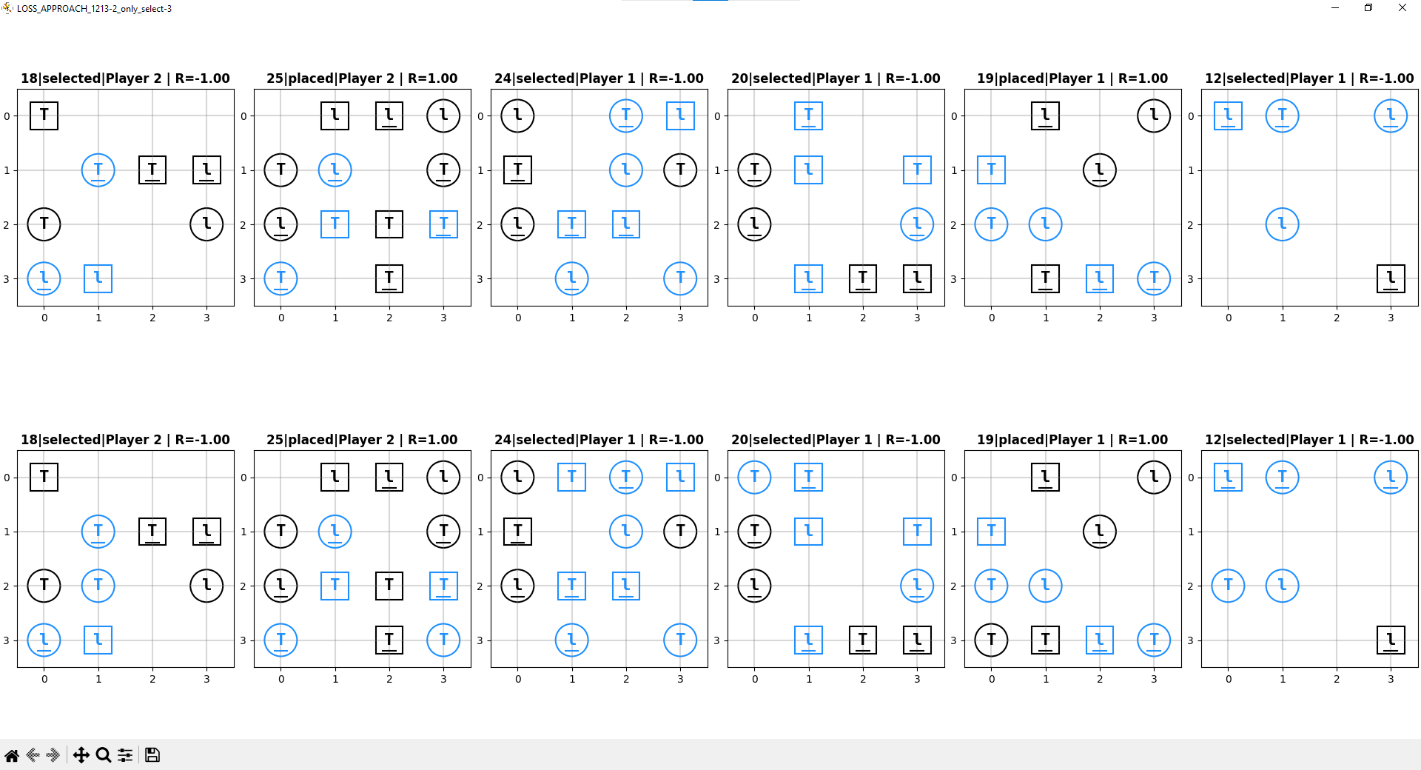

Slide 3
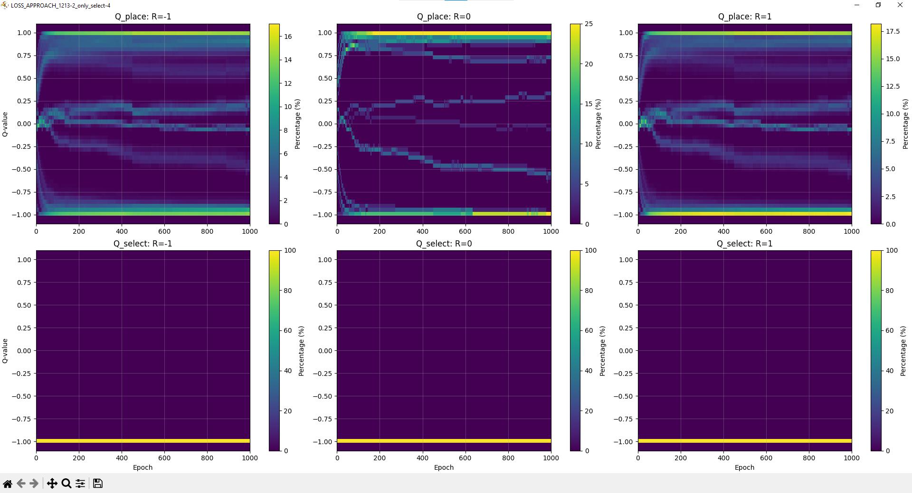

Slide 4
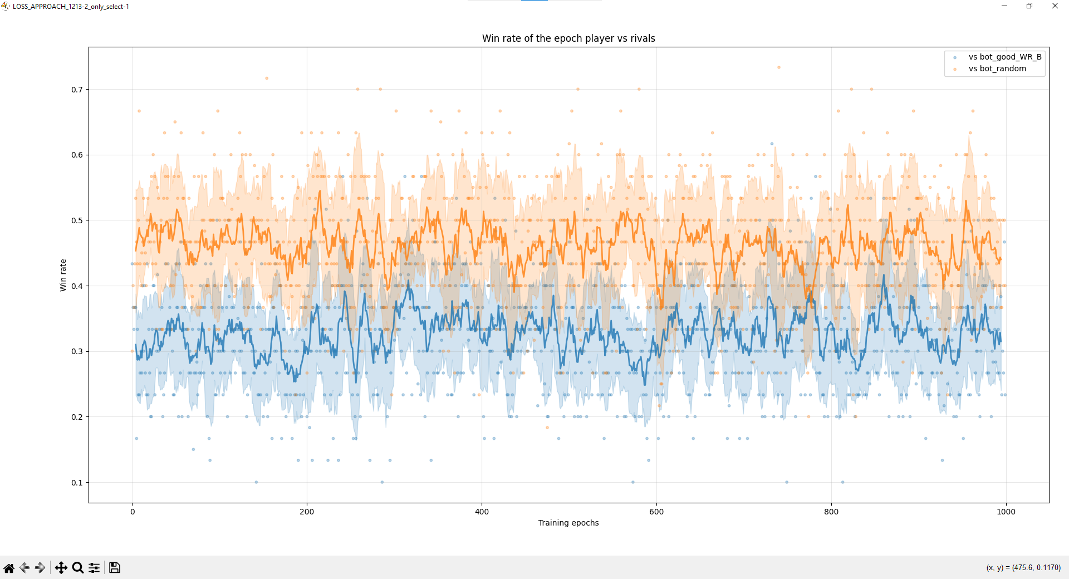

Slide 5
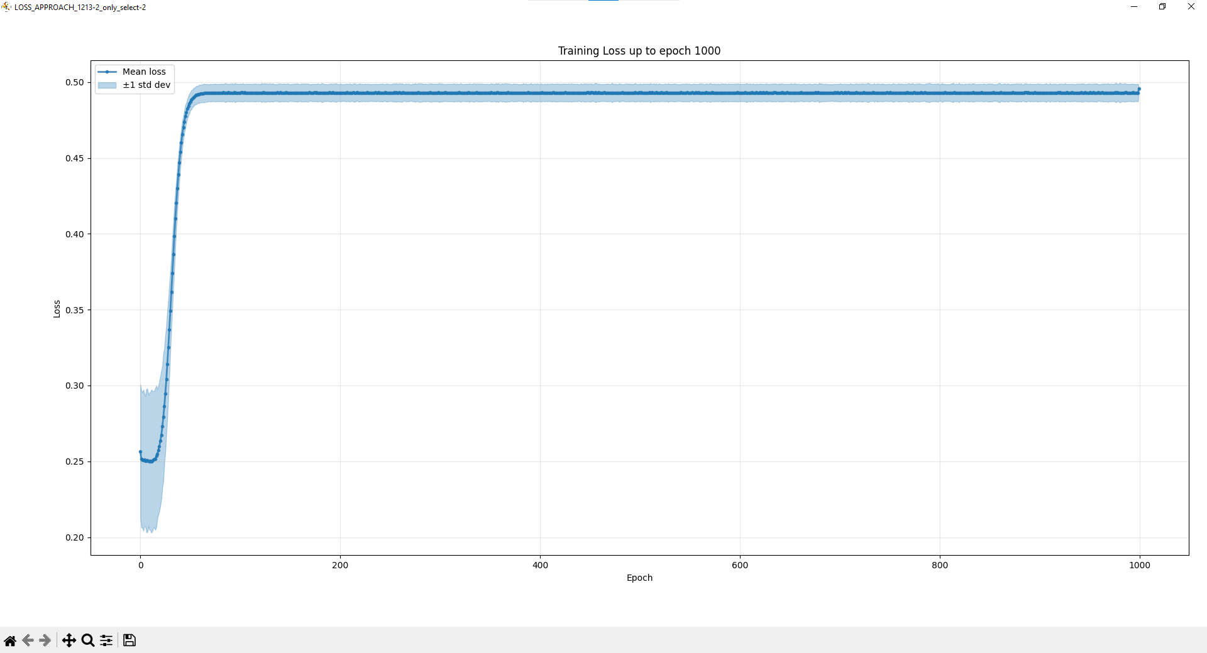

Slide 6
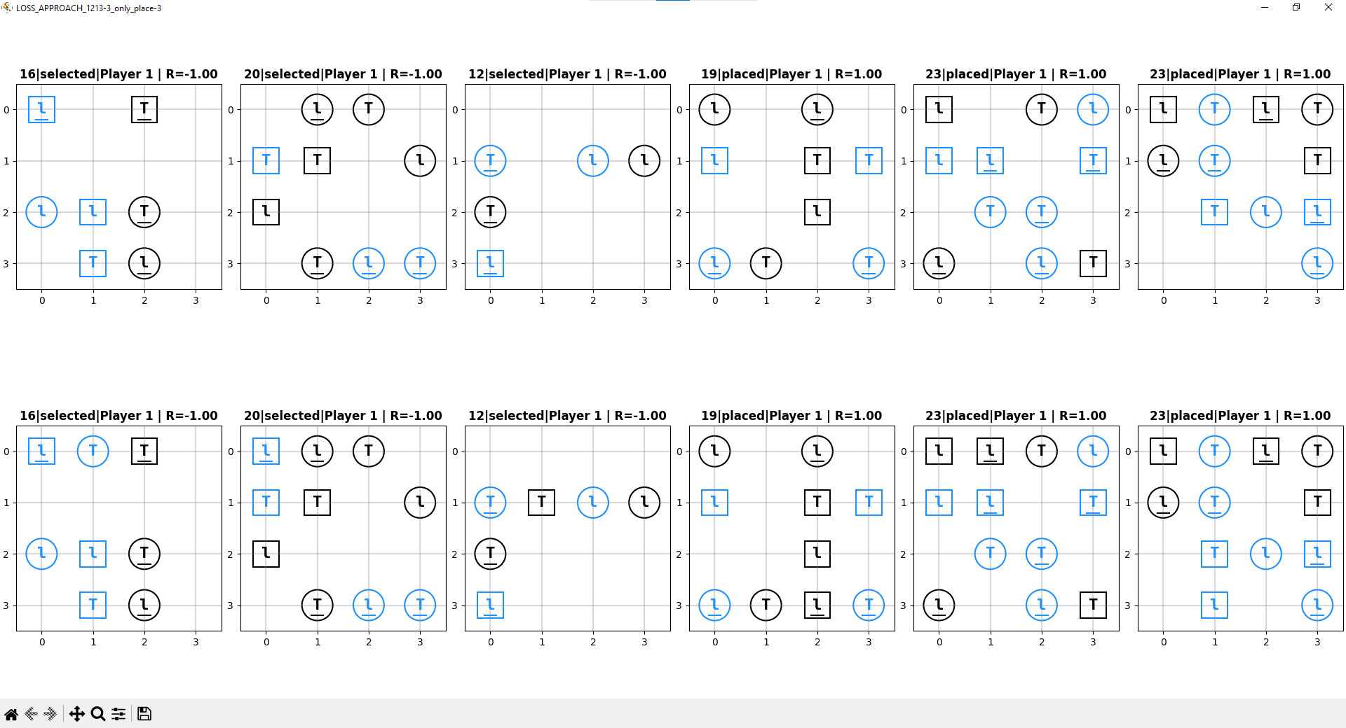

Slide 7
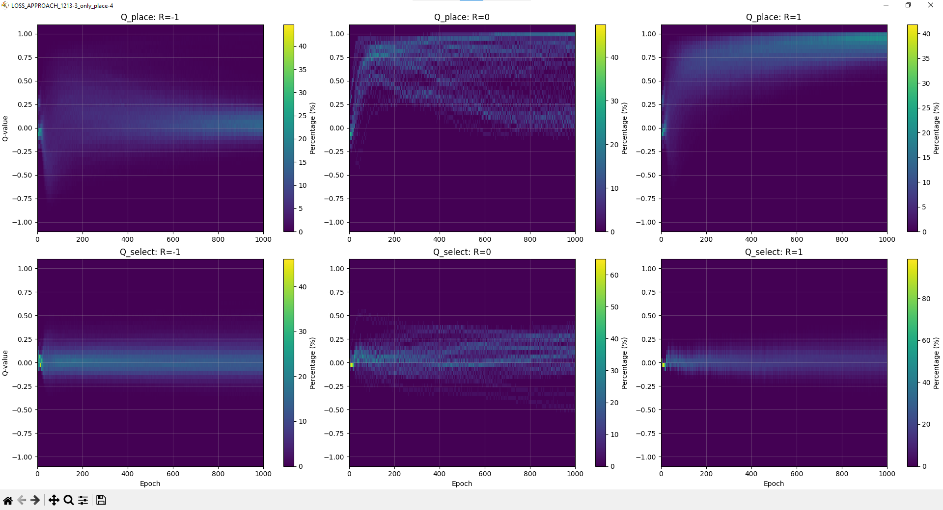

Slide 8
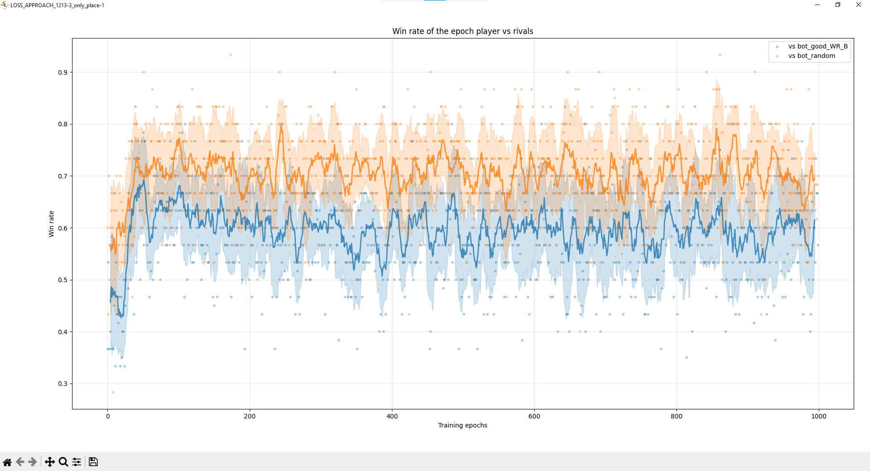

Slide 9
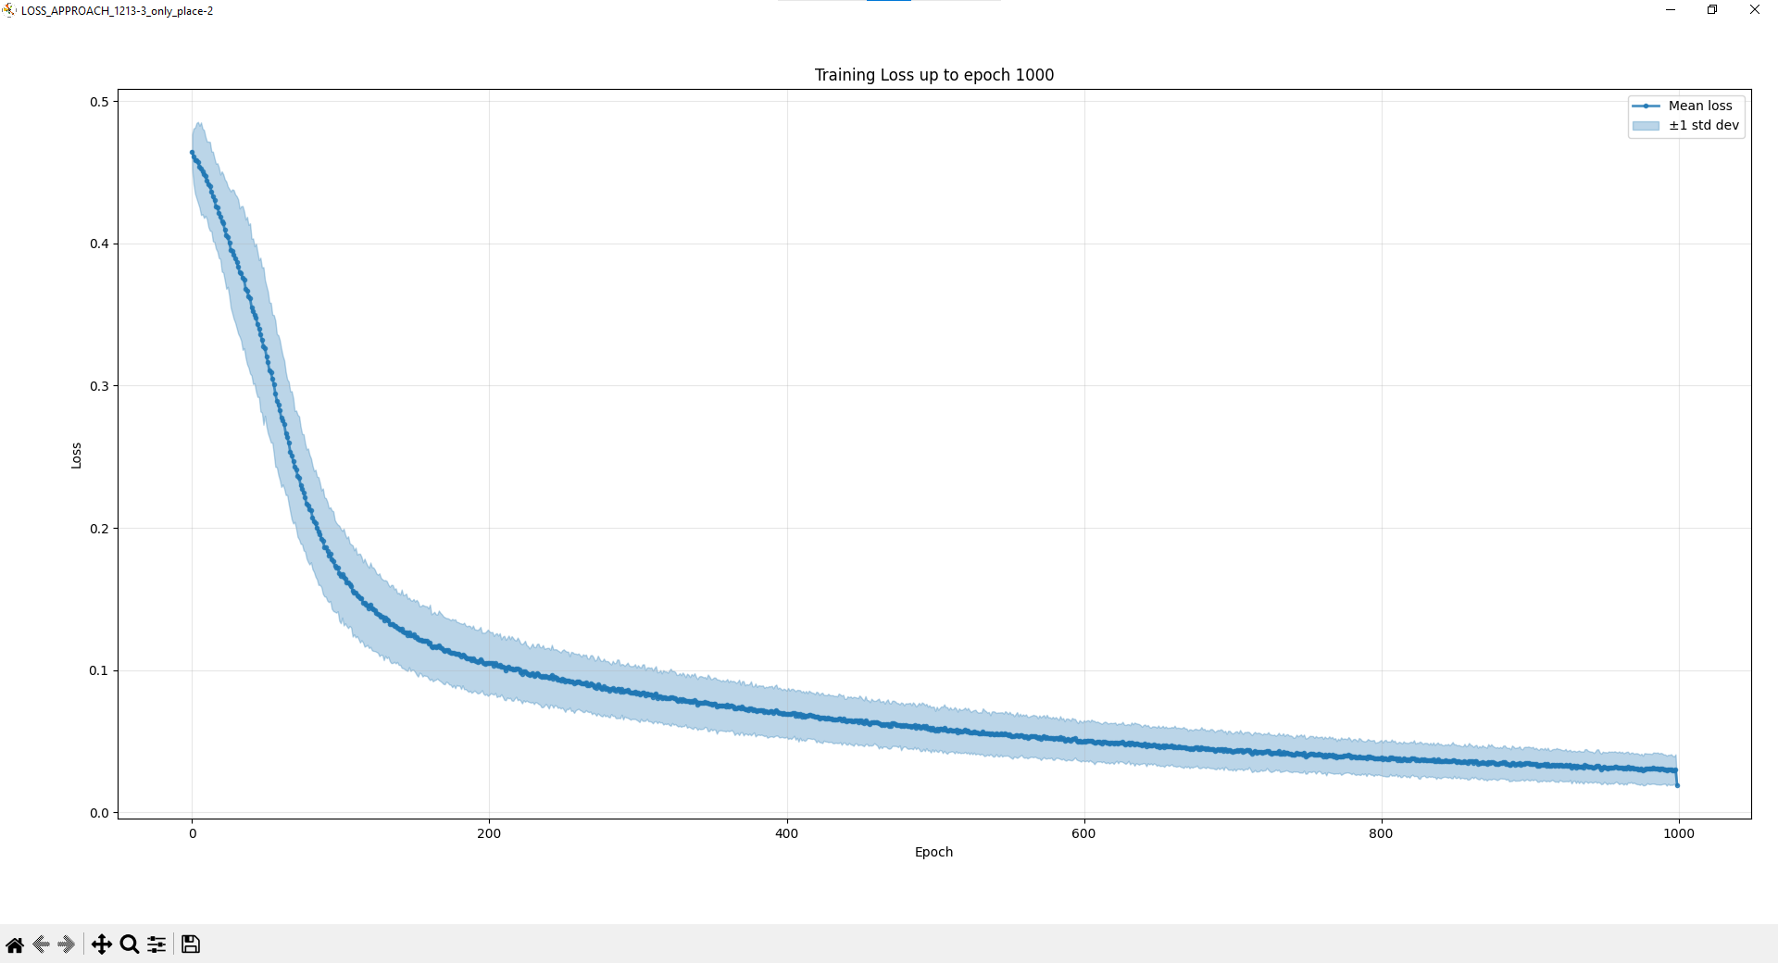

Slide 10
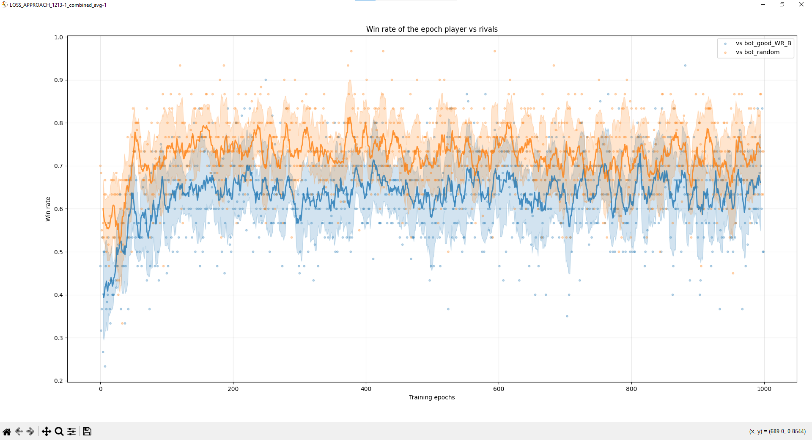

Slide 11
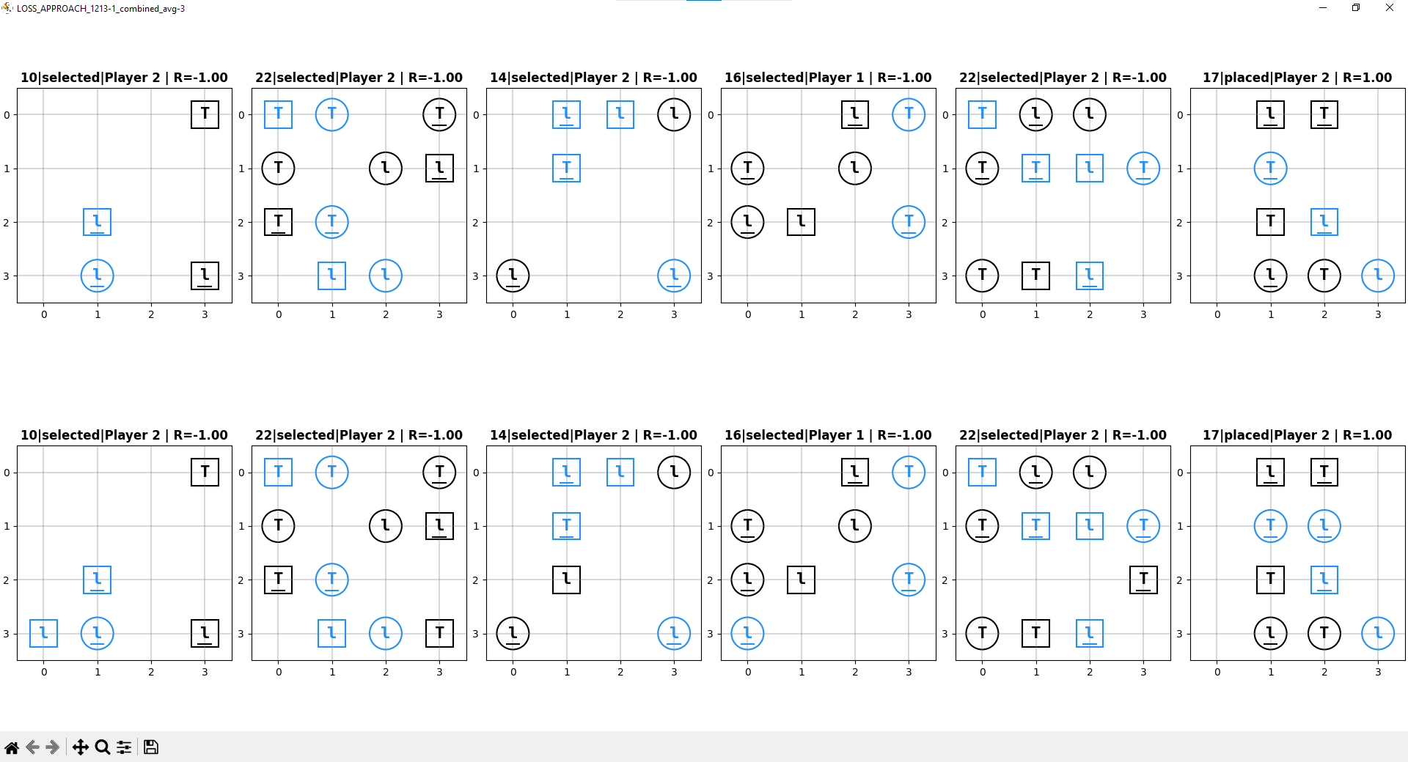

Slide 12
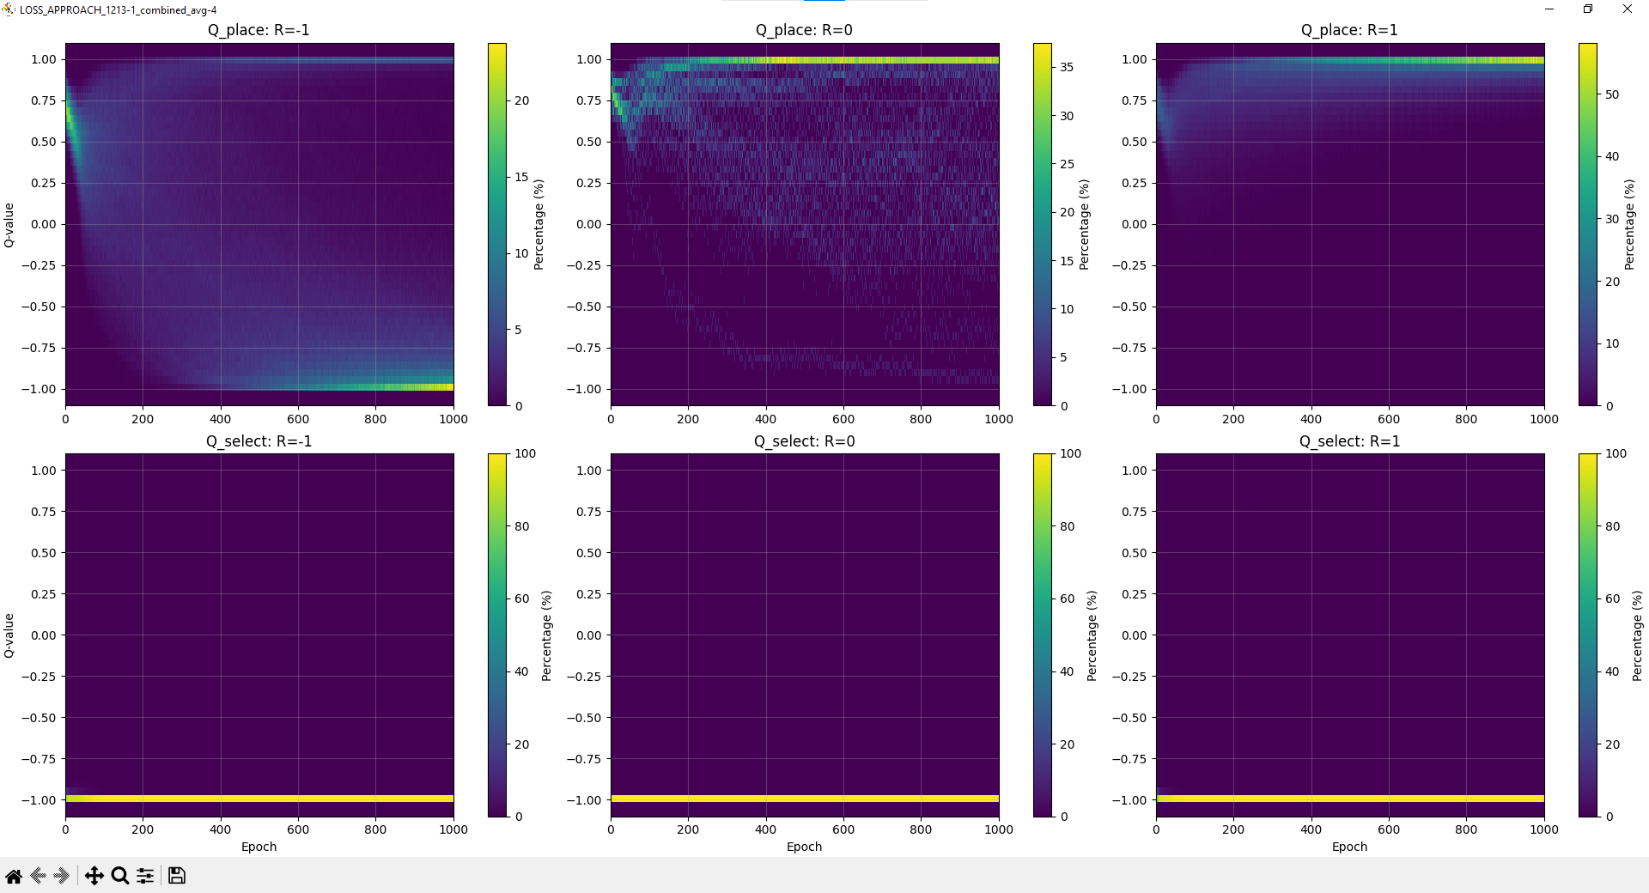

Slide 13
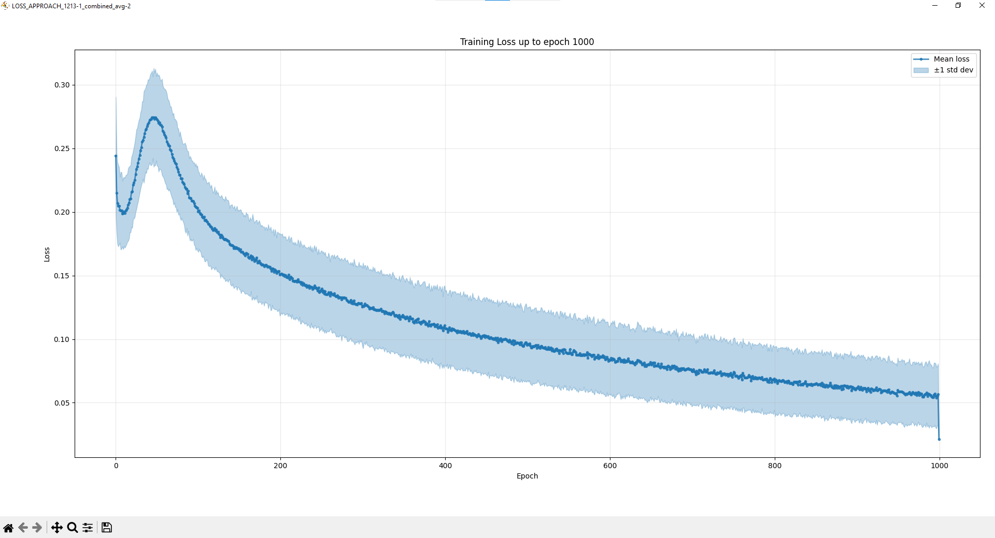

Slide 14
2
PC name: ALAN-TURING
Experiment name: N_LAST_STATES_FINAL_1215-1_2
Train conf.: EPOCHS=10000, BATCH_SIZE=256, LR=5e-05, LR_F=5e-05, GAMMA=0.99, TAU=0.01, MAX_GRAD_NORM=1.0
Exp. gen.: MATCHES_PER_EPOCH=64, STEPS_PER_EPOCH=128, REPLAY_SIZE=64000
Network updates: ITER_PER_EPOCH=0, N_BATCHS_2_UPDATE_TARGET=0
Exploration: TEMPERATURE_EXPLORE=2, TEMPERATURE_EXPLOIT=0.1
N_LAST_STATES: INIT=2, FINAL=2
LOSS_APPROACH=combined_avg
REWARD_FUNCTION=propagate
Using device: cuda
Architecture: QuartoCNN_uncoupled

Slide 15
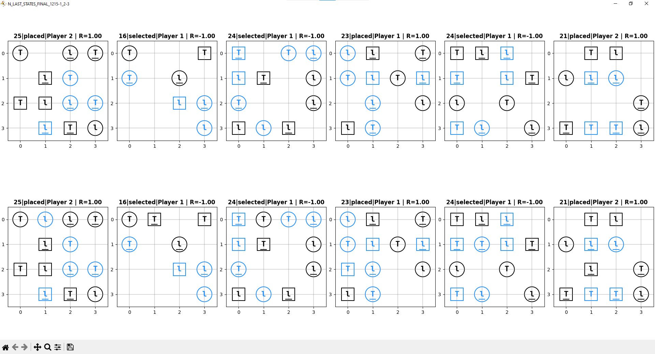

Slide 16
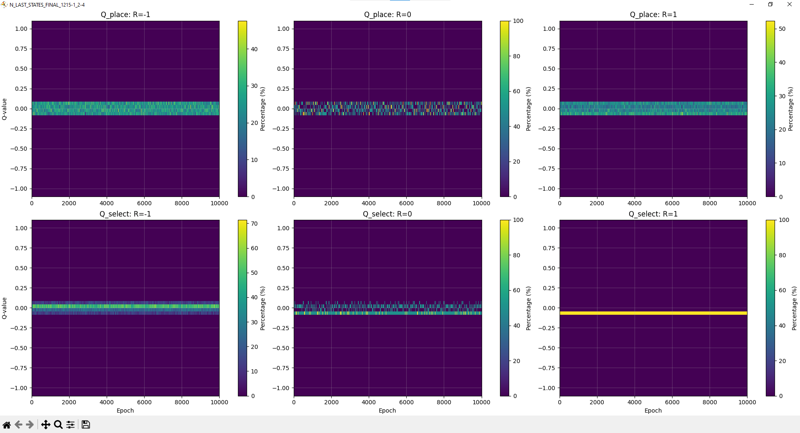

Slide 17
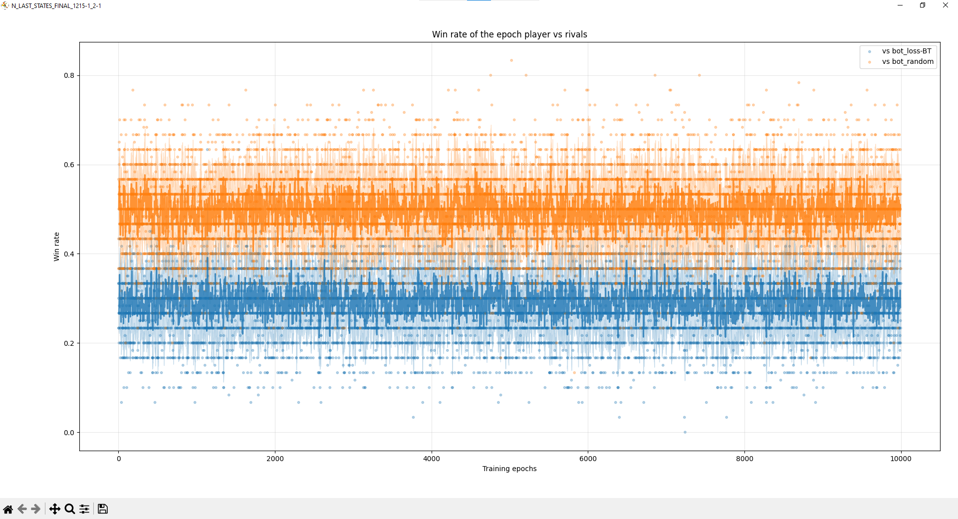

Slide 18
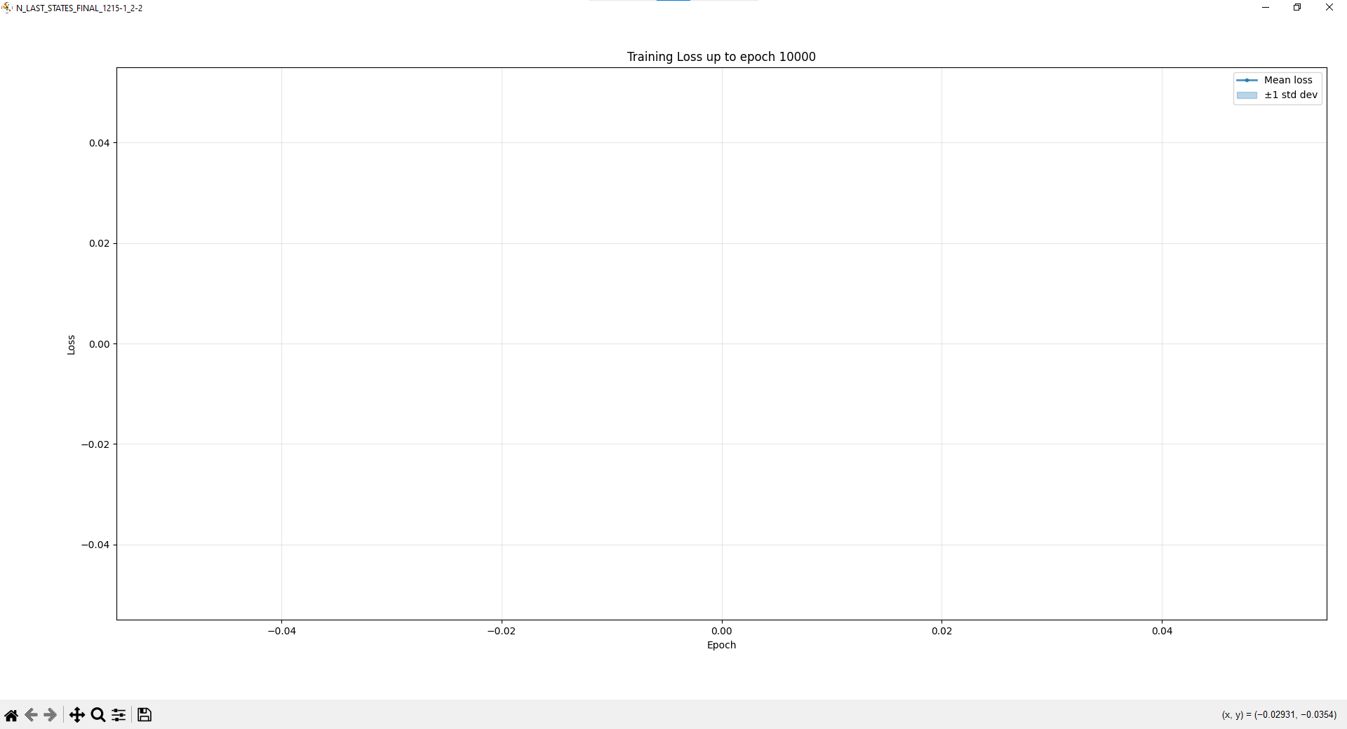

Slide 19
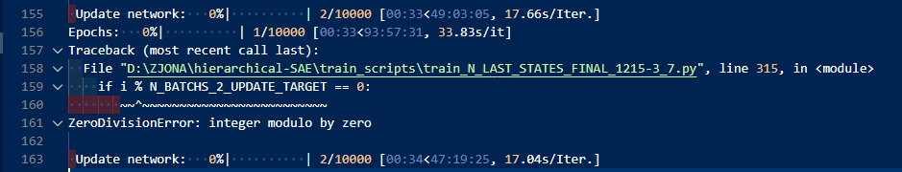
4,7,10

Slide 20
13
PC name: ALAN-TURING
Experiment name: N_LAST_STATES_FINAL_1215-5_13
Train conf.: EPOCHS=10000, BATCH_SIZE=256, LR=5e-05, LR_F=5e-05, GAMMA=0.99, TAU=0.01, MAX_GRAD_NORM=1.0
Exp. gen.: MATCHES_PER_EPOCH=64, STEPS_PER_EPOCH=832, REPLAY_SIZE=416000
Network updates: ITER_PER_EPOCH=3, N_BATCHS_2_UPDATE_TARGET=1
Exploration: TEMPERATURE_EXPLORE=2, TEMPERATURE_EXPLOIT=0.1
N_LAST_STATES: INIT=2, FINAL=13
LOSS_APPROACH=combined_avg
REWARD_FUNCTION=propagate
Using device: cuda
Architecture: QuartoCNN_uncoupled
Models moved to cuda
Starting with random weights (no checkpoint provided)

Slide 21
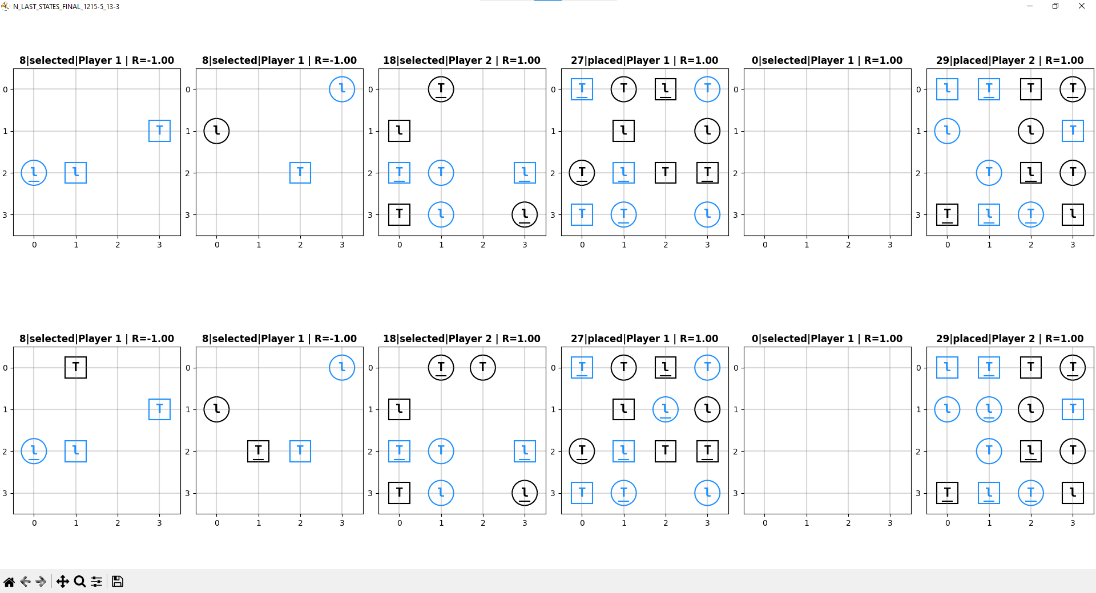

Slide 22
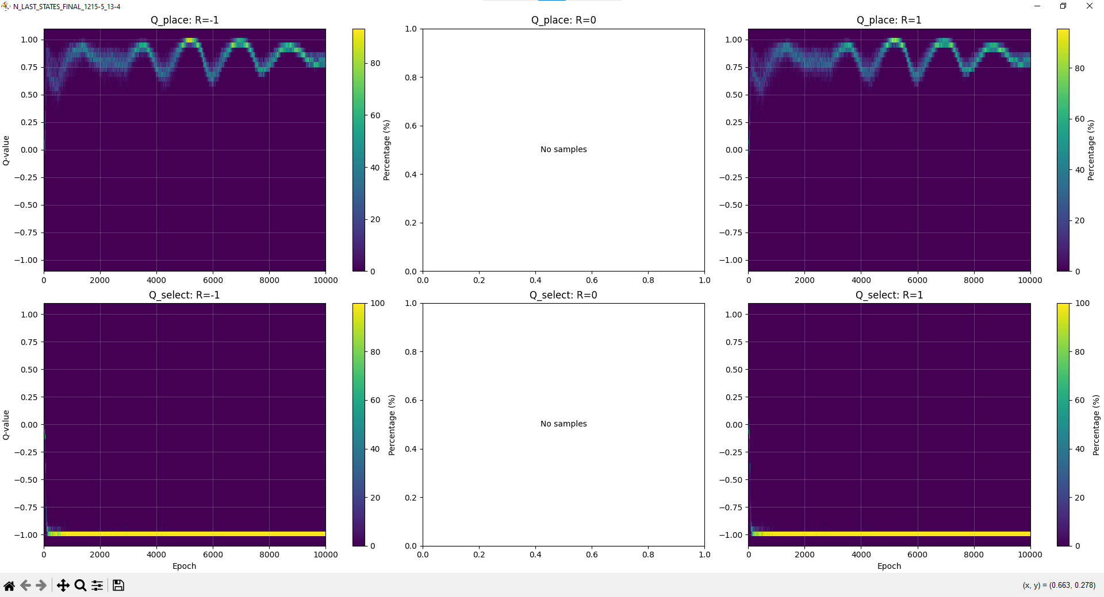

Slide 23
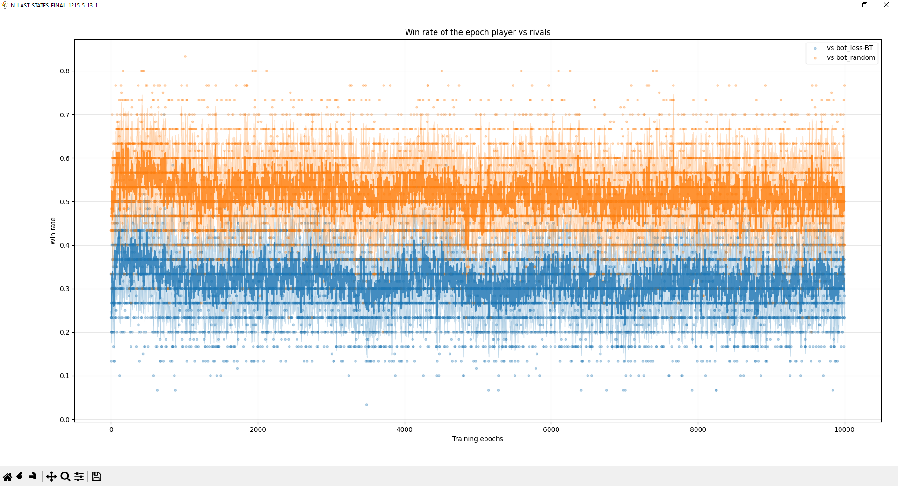

Slide 24
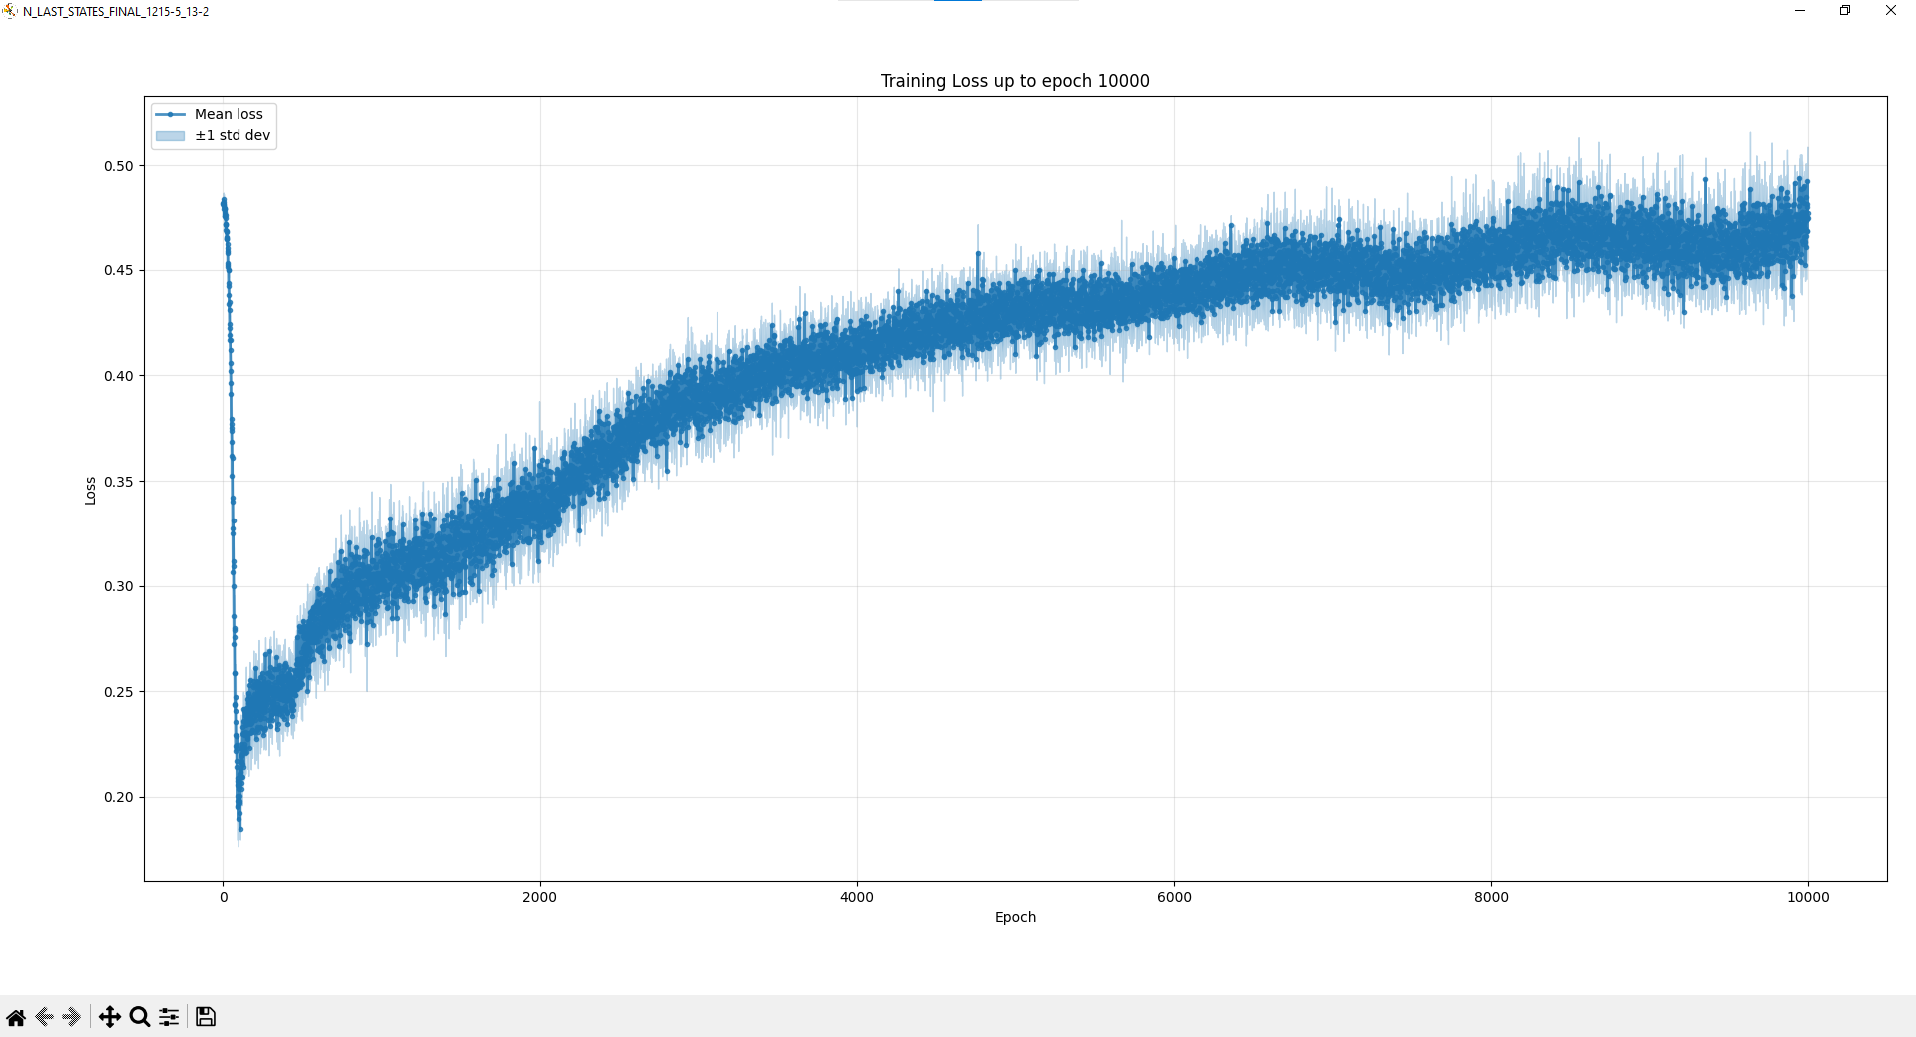

Slide 25
16
Experiment name: N_LAST_STATES_FINAL_1215-6_16
Train conf.: EPOCHS=10000, BATCH_SIZE=256, LR=5e-05, LR_F=5e-05, GAMMA=0.99, TAU=0.01, MAX_GRAD_NORM=1.0
Exp. gen.: MATCHES_PER_EPOCH=64, STEPS_PER_EPOCH=1024, REPLAY_SIZE=512000
Network updates: ITER_PER_EPOCH=4, N_BATCHS_2_UPDATE_TARGET=1
Exploration: TEMPERATURE_EXPLORE=2, TEMPERATURE_EXPLOIT=0.1
N_LAST_STATES: INIT=2, FINAL=16
LOSS_APPROACH=combined_avg
REWARD_FUNCTION=propagate
Using device: cuda
Architecture: QuartoCNN_uncoupled
Models moved to cuda
Starting with random weights (no checkpoint provided)

Slide 26
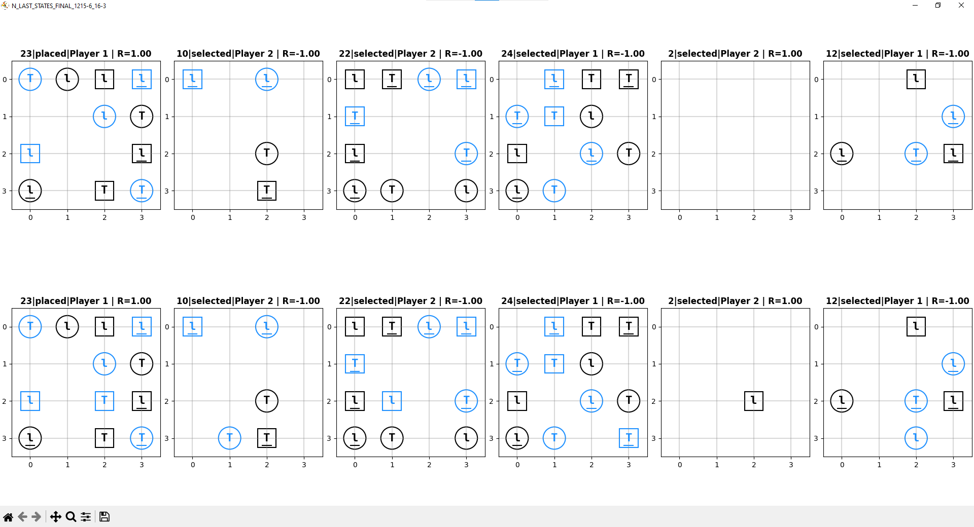

Slide 27
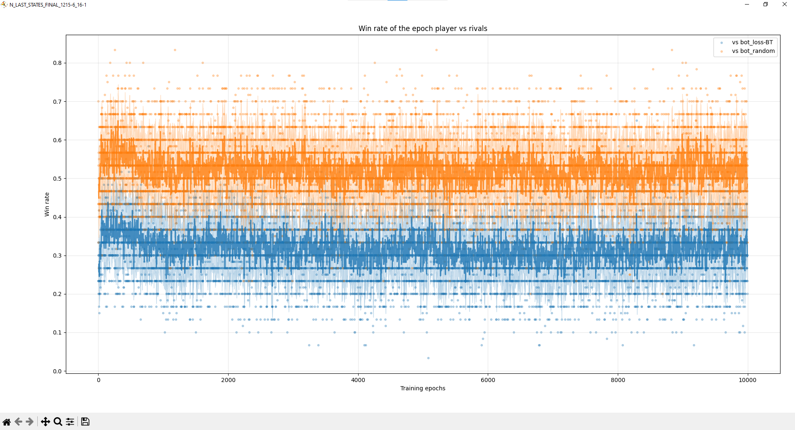

Slide 28
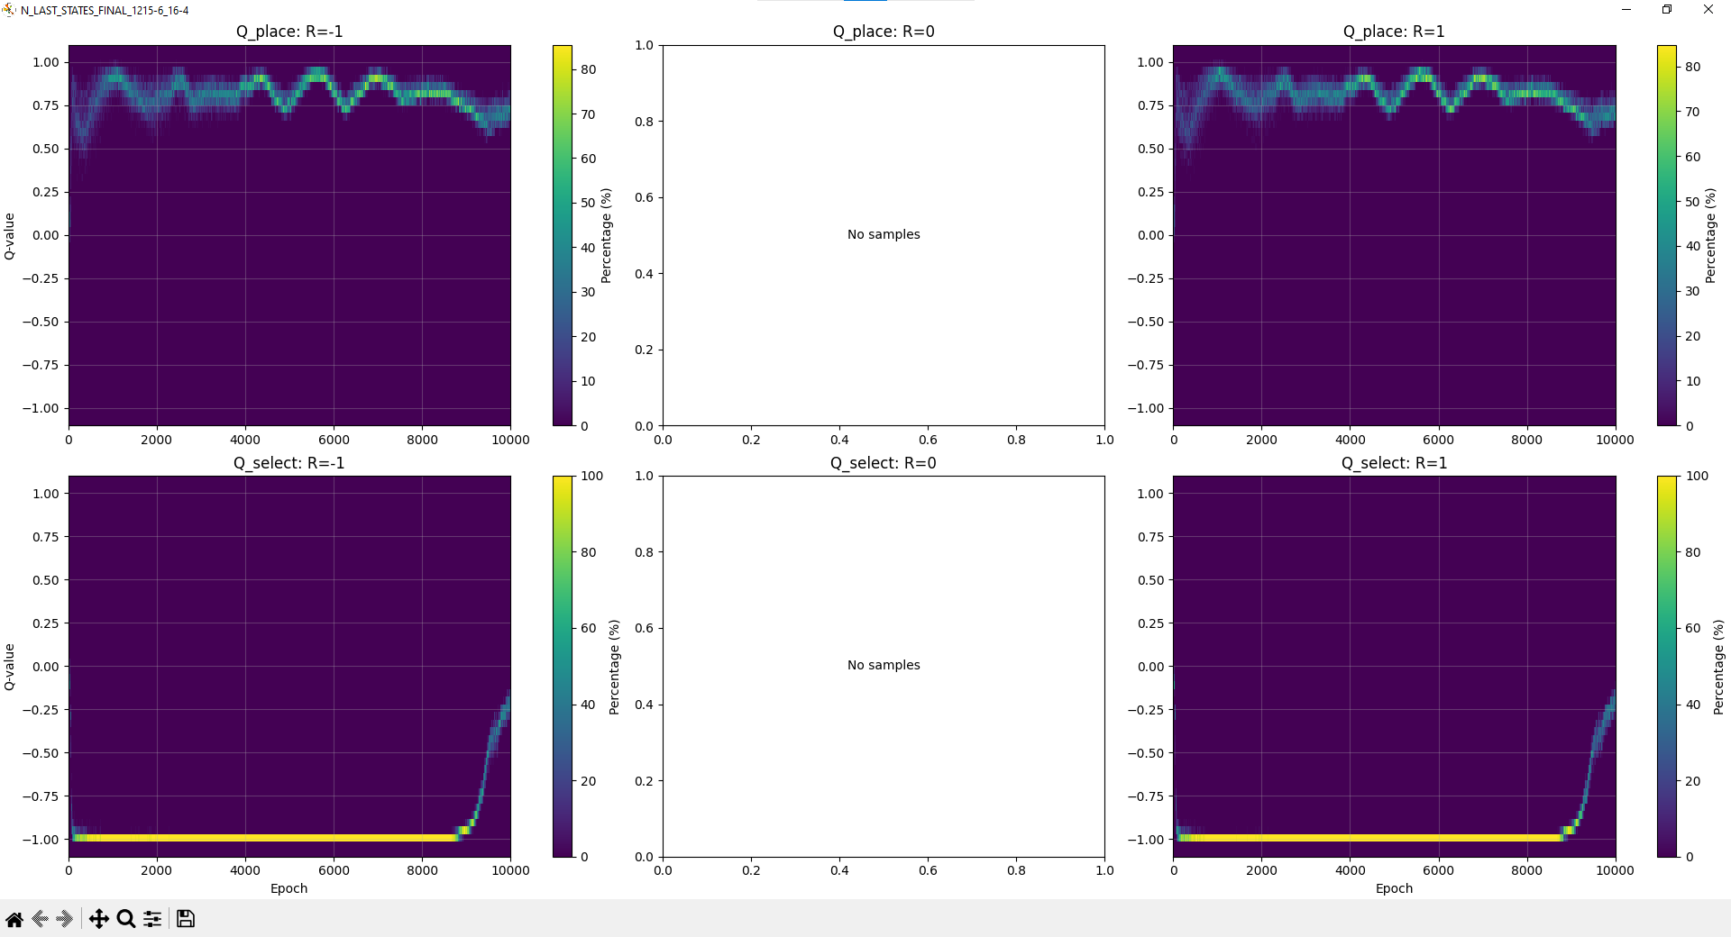

Slide 29
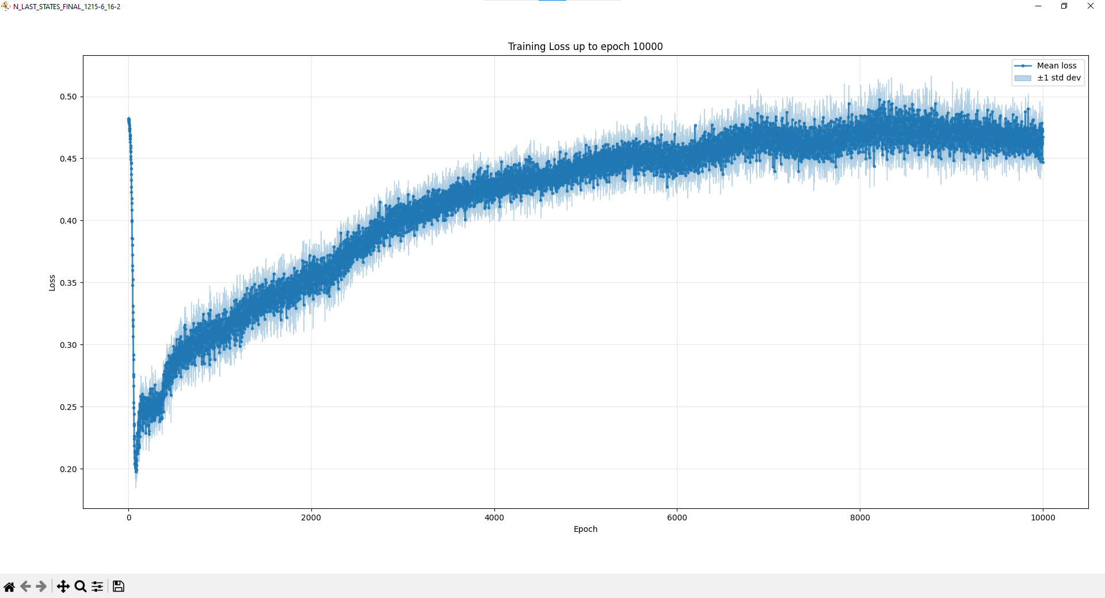

Slide 30
[01-19 09:04:02][INFO][trainRL.py] Starting Importing...
[01-19 09:04:41][INFO][trainRL.py] Imports done.
[01-19 09:04:41][INFO][trainRL.py] PC name: ALAN-TURING
[01-19 09:04:41][INFO][trainRL.py] Experiment name: _B01_States
[01-19 09:04:41][INFO][trainRL.py] Train conf.: EPOCHS=10000, BATCH_SIZE=32, LR=5e-05,
LR_F=5e-05, GAMMA=0.99, TAU=0.01, MAX_GRAD_NORM=1.0
[01-19 09:04:41][INFO][trainRL.py] Exp. gen.: MATCHES_PER_EPOCH=32, STEPS_PER_EPOCH=512,
REPLAY_SIZE=65536
[01-19 09:04:41][INFO][trainRL.py] Network updates: ITER_PER_EPOCH=16, N_BATCHS_2_UPDATE_TARGET=16
[01-19 09:04:41][INFO][trainRL.py] Exploration: TEMPERATURE_EXPLORE=2, TEMPERATURE_EXPLOIT=0.1
[01-19 09:04:41][INFO][trainRL.py] N_LAST_STATES: INIT=2, FINAL=16
[01-19 09:04:41][INFO][trainRL.py] LOSS_APPROACH=combined_avg
[01-19 09:04:41][INFO][trainRL.py] REWARD_FUNCTION=propagate
[01-19 09:04:42][INFO][trainRL.py] Using device: cuda
[01-19 09:04:42][INFO][trainRL.py] Architecture: QuartoCNN_uncoupled
[01-19 09:04:42][INFO][trainRL.py] Models moved to cuda
[01-19 09:04:42][INFO][trainRL.py] Starting with random weights (no checkpoint provided)
[01-19 09:04:42][INFO][trainRL.py] Hyperparameters loaded.

Slide 31
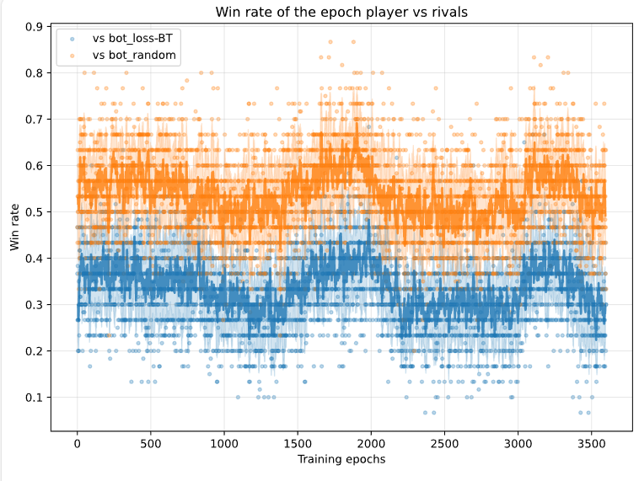

Slide 32
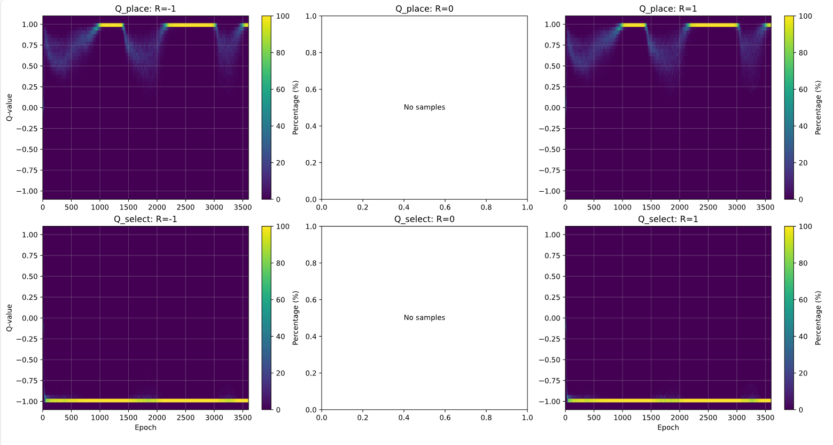

Slide 33
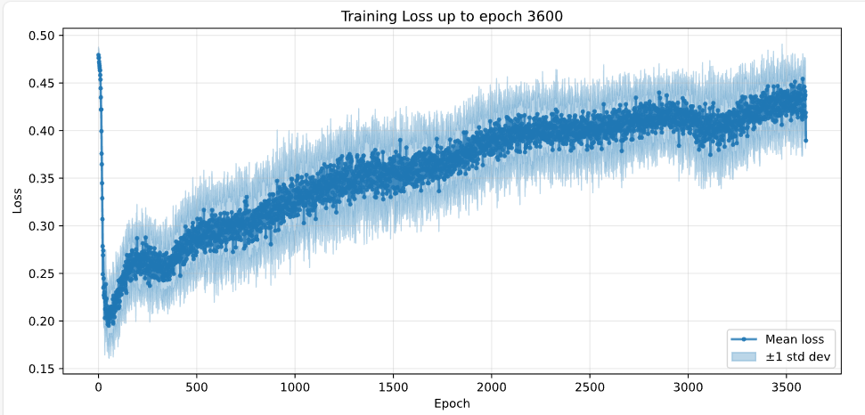

Slide 34
Only last 2 states!
[01-19 09:11:28][INFO][trainRL.py] Experiment name: B02_verify
[01-19 09:11:28][INFO][trainRL.py] Train conf.: EPOCHS=10000, BATCH_SIZE=32, LR=5e-05, LR_F=5e-05, GAMMA=0.99, TAU=0.01, MAX_GRAD_NORM=1.0
[01-19 09:11:28][INFO][trainRL.py] Exp. gen.: MATCHES_PER_EPOCH=32, STEPS_PER_EPOCH=64, REPLAY_SIZE=8192
[01-19 09:11:28][INFO][trainRL.py] Network updates: ITER_PER_EPOCH=2, N_BATCHS_2_UPDATE_TARGET=2
[01-19 09:11:28][INFO][trainRL.py] Exploration: TEMPERATURE_EXPLORE=2, TEMPERATURE_EXPLOIT=0.1
[01-19 09:11:28][INFO][trainRL.py] N_LAST_STATES: INIT=2, FINAL=2
[01-19 09:11:28][INFO][trainRL.py] LOSS_APPROACH=combined_avg
[01-19 09:11:28][INFO][trainRL.py] REWARD_FUNCTION=propagate
[01-19 09:11:28][INFO][trainRL.py] Using device: cuda
[01-19 09:11:28][INFO][trainRL.py] Architecture: QuartoCNN_uncoupled
[01-19 09:11:29][INFO][trainRL.py] Models moved to cuda
[01-19 09:11:29][INFO][trainRL.py] Starting with random weights (no checkpoint provided)

Slide 35
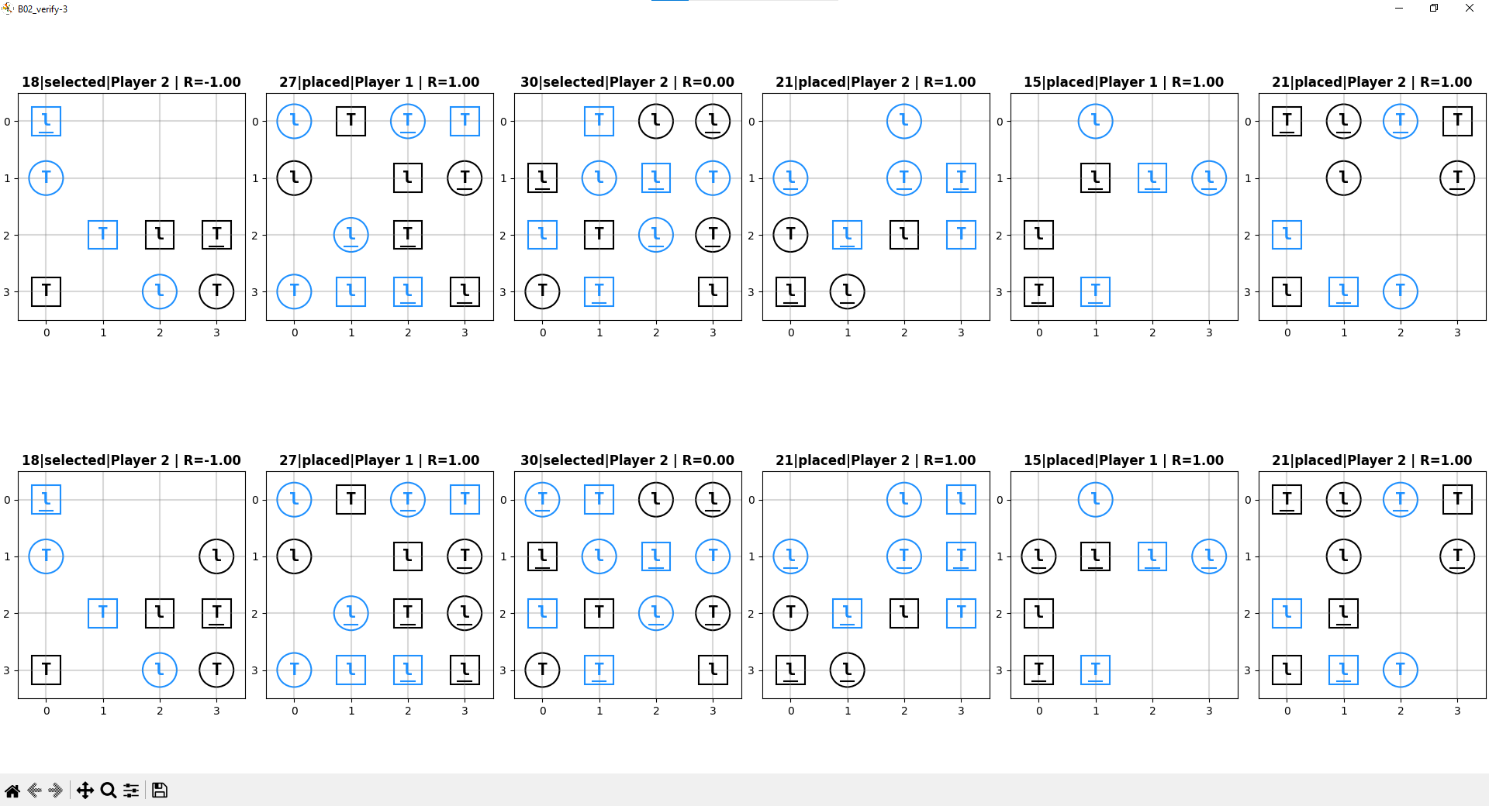

Slide 36
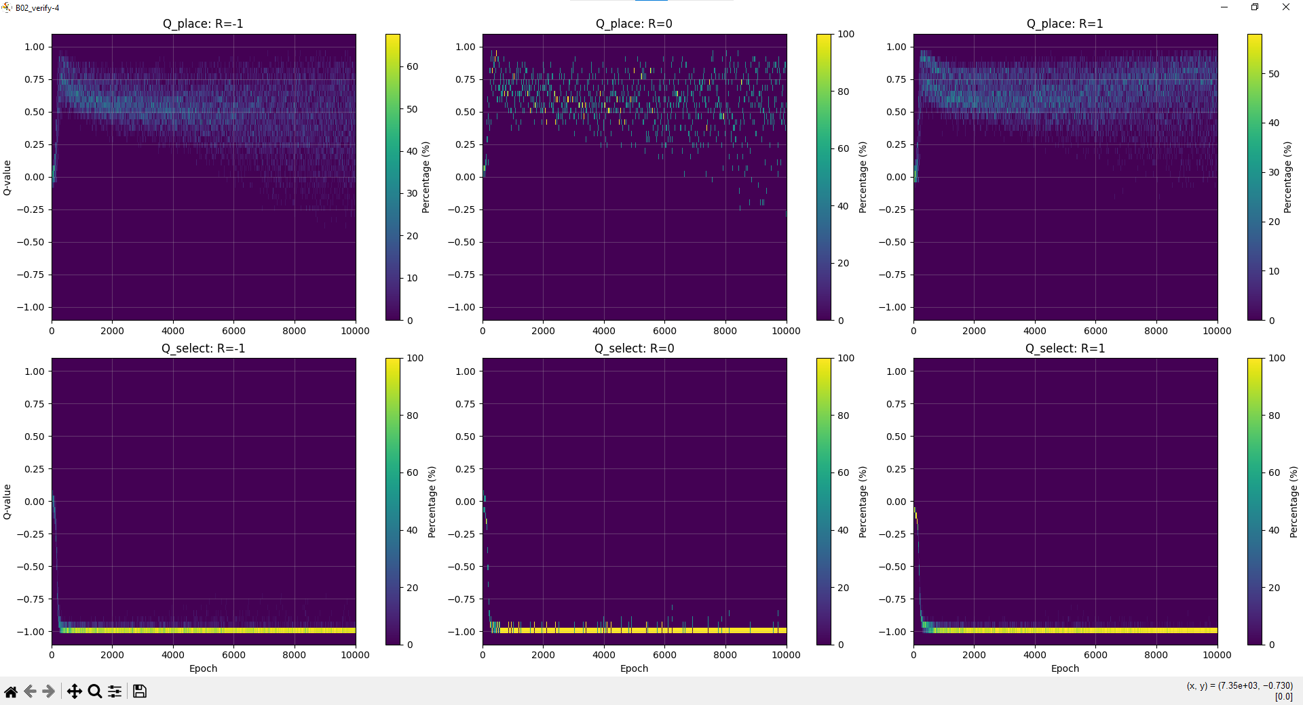

Slide 37
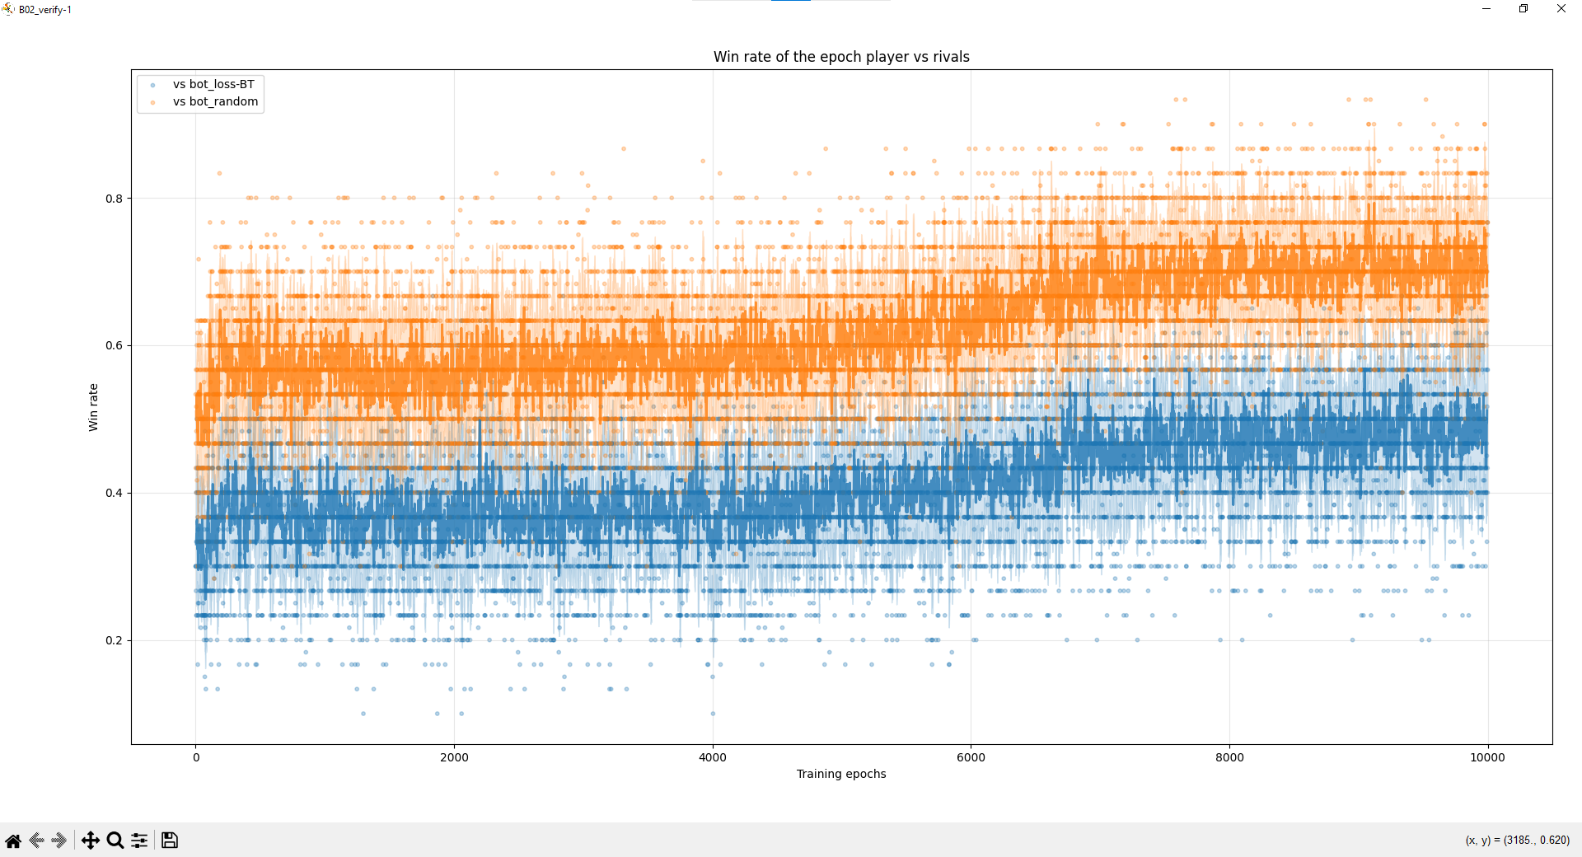

Slide 38
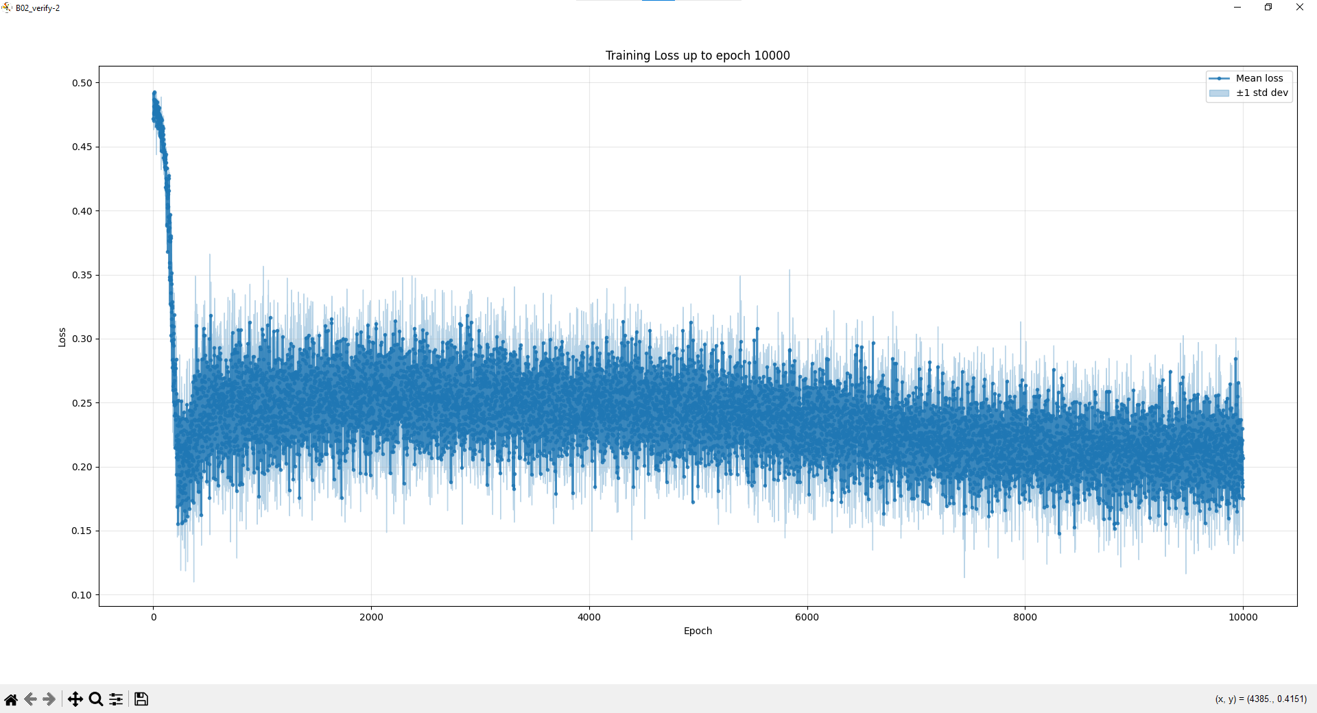

Slide 39
[01-21 11:52:34][INFO][B02replicate(6)0121_LR_0.0005.py] PC name: ALAN-TURING
Experiment name: B02replicate(6)0121_LR_0.0005
Train conf.: EPOCHS=10000, BATCH_SIZE=32, LR=0.0005, LR_F=0.0005, GAMMA=0.99, TAU=0.01, MAX_GRAD_NORM=1.0
Exp. gen.: MATCHES_PER_EPOCH=32, STEPS_PER_EPOCH=64, REPLAY_SIZE=8192
Network updates: ITER_PER_EPOCH=2, N_BATCHS_2_UPDATE_TARGET=2
Exploration: TEMPERATURE_EXPLORE=2, TEMPERATURE_EXPLOIT=0.1
N_LAST_STATES: INIT=2, FINAL=2
LOSS_APPROACH=combined_avg
REWARD_FUNCTION=propagate
Using device: cuda
Architecture: QuartoCNN_uncoupled
Models moved to cuda
Starting with random weights (no checkpoint provided)

Slide 40
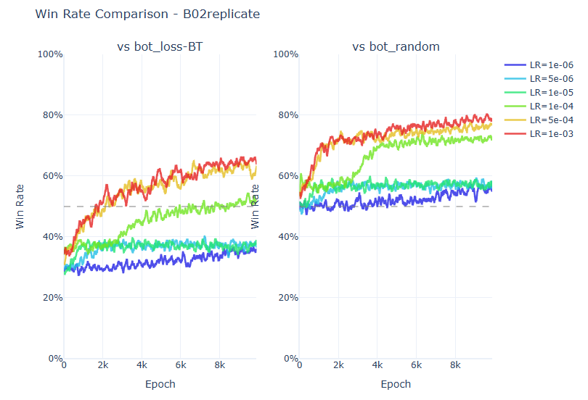

Slide 41
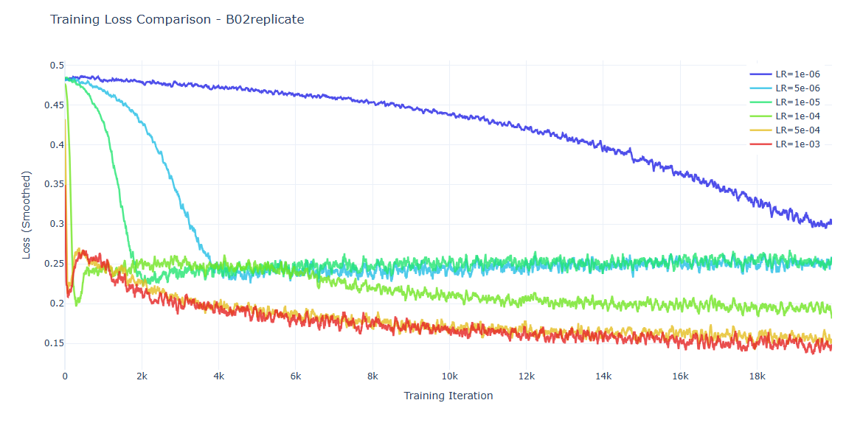

Slide 42
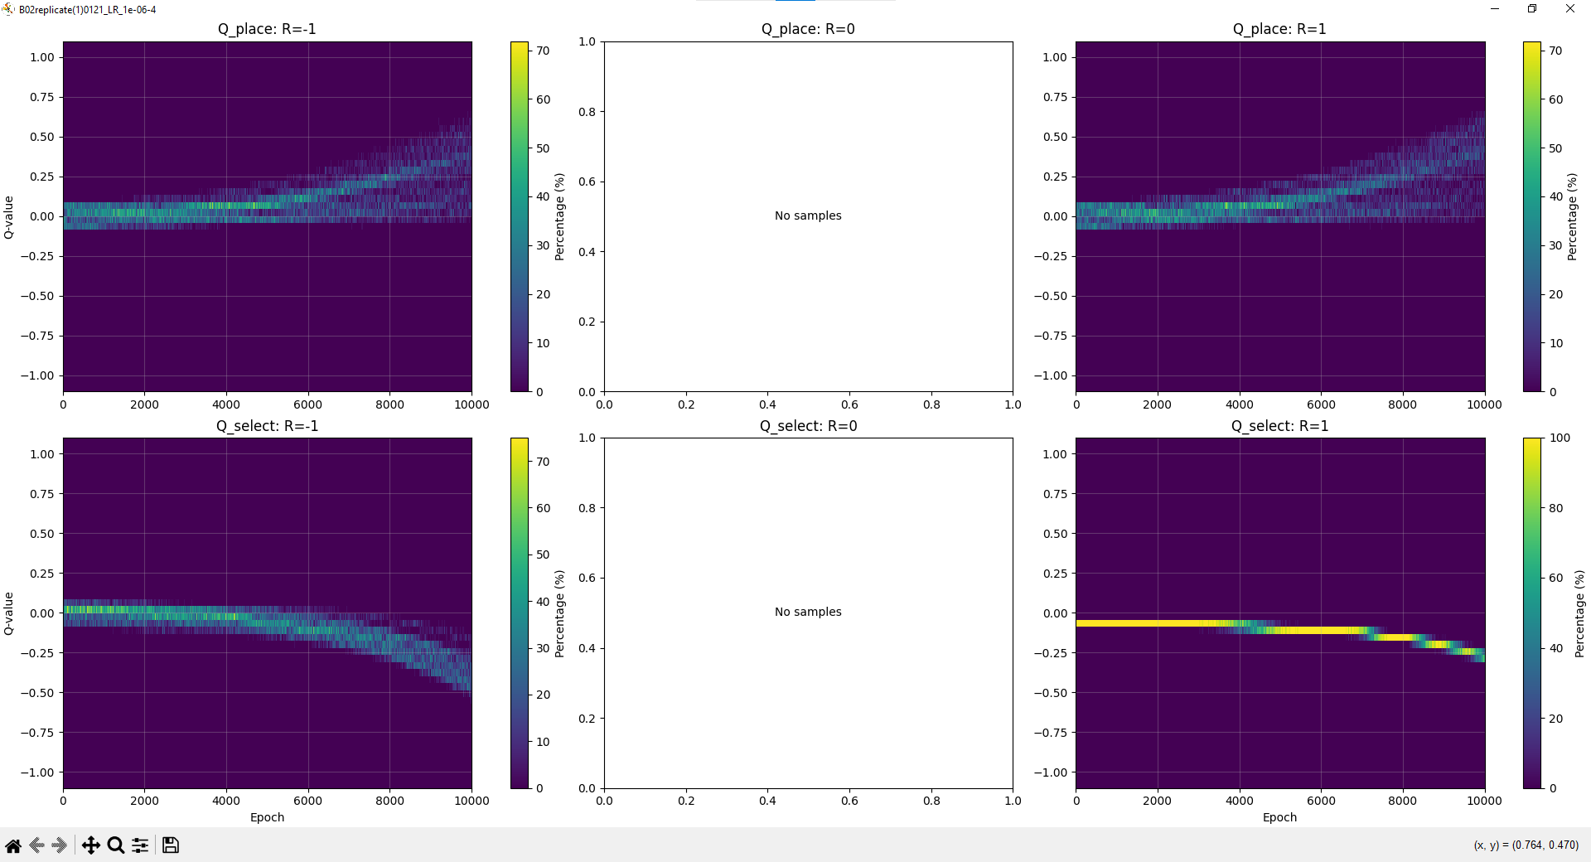

Slide 43
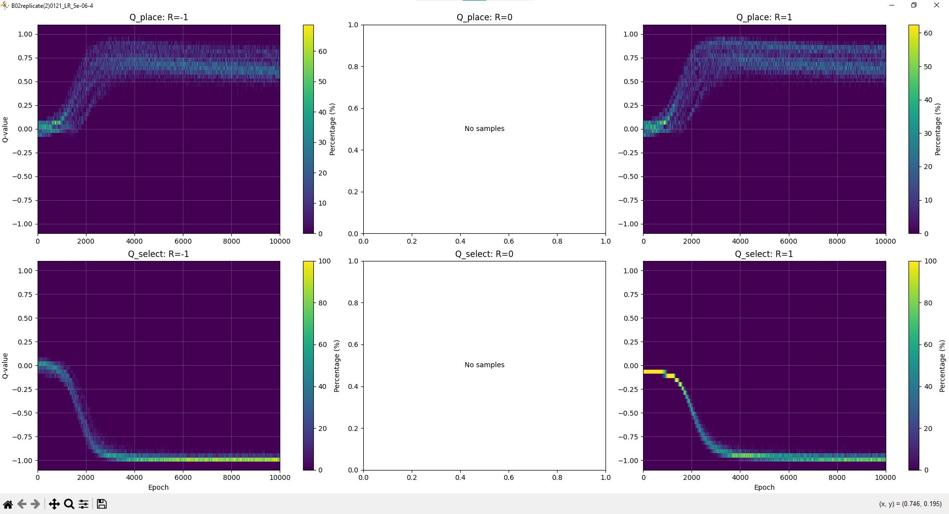

Slide 44
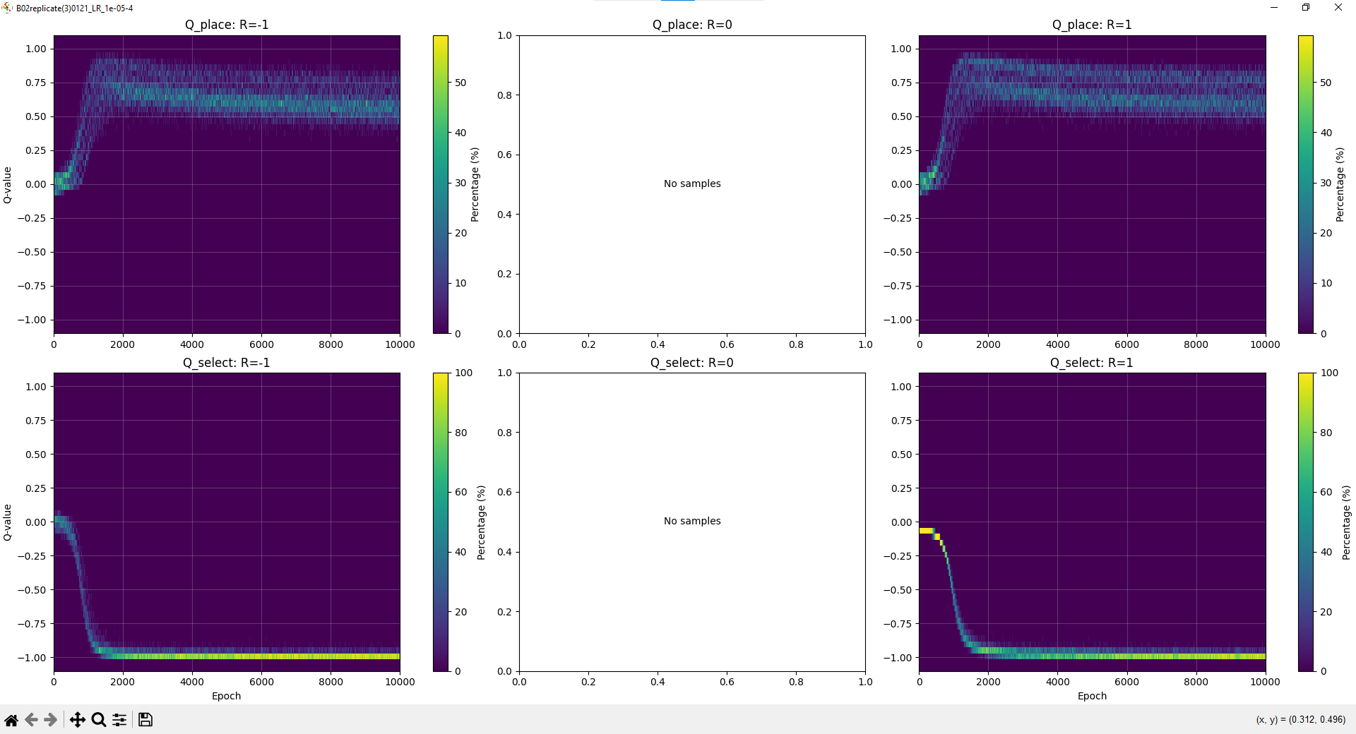

Slide 45
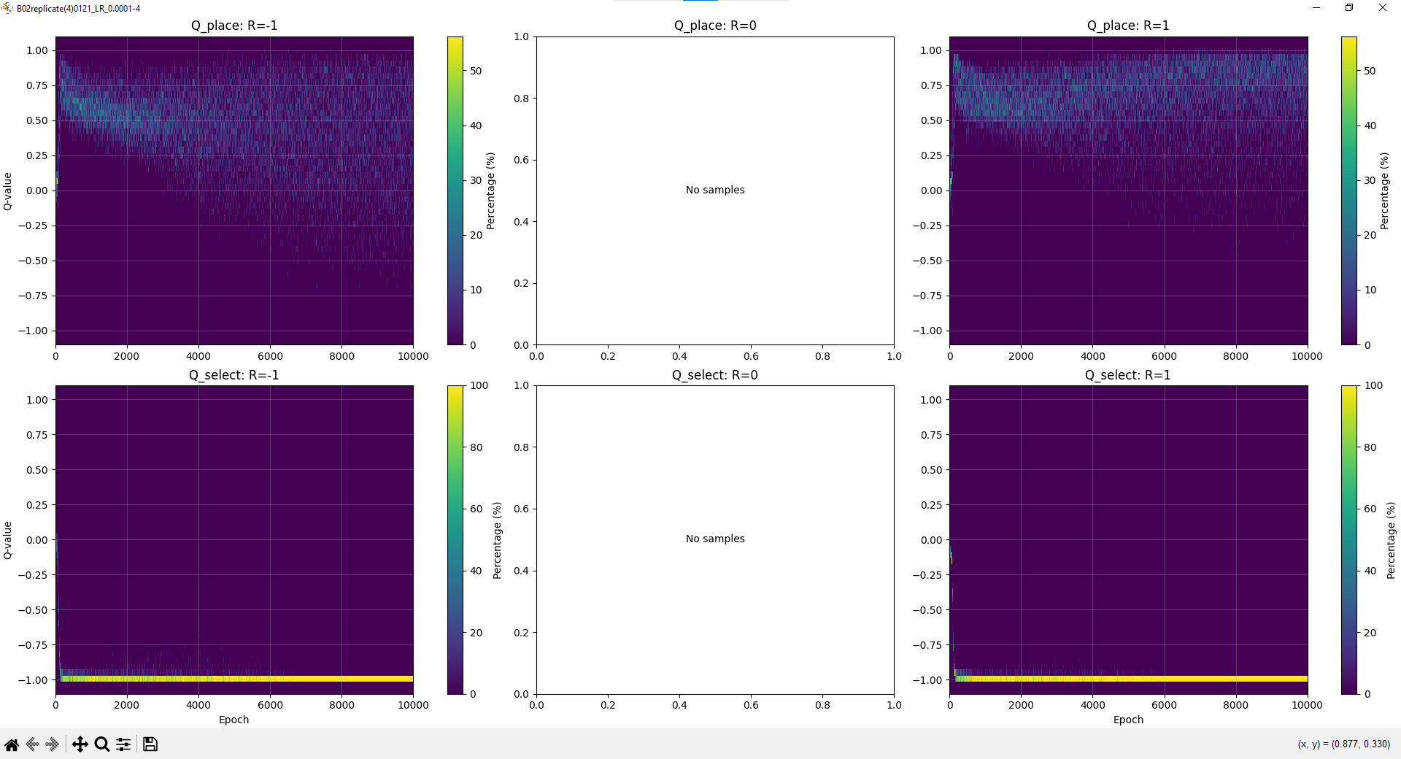

Slide 46
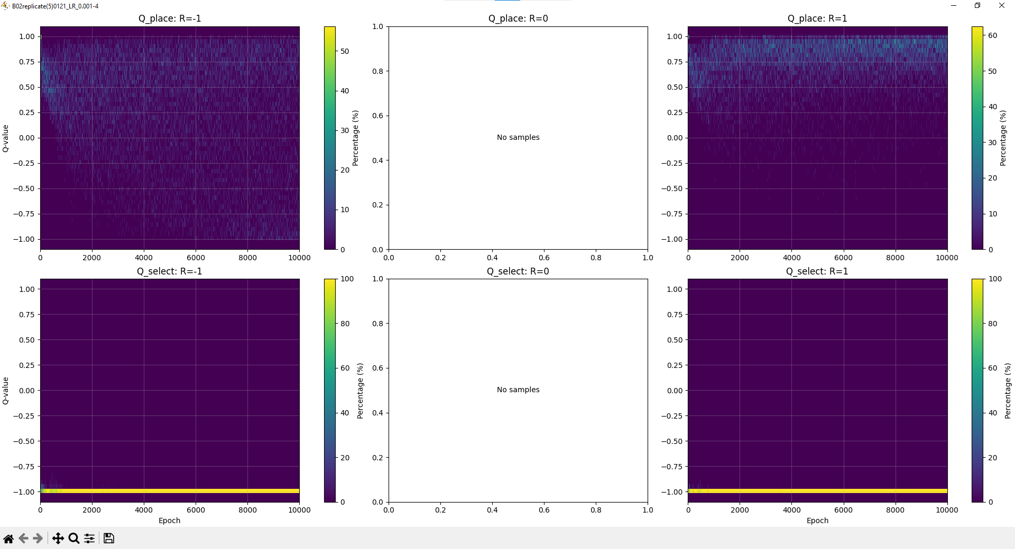

Slide 47
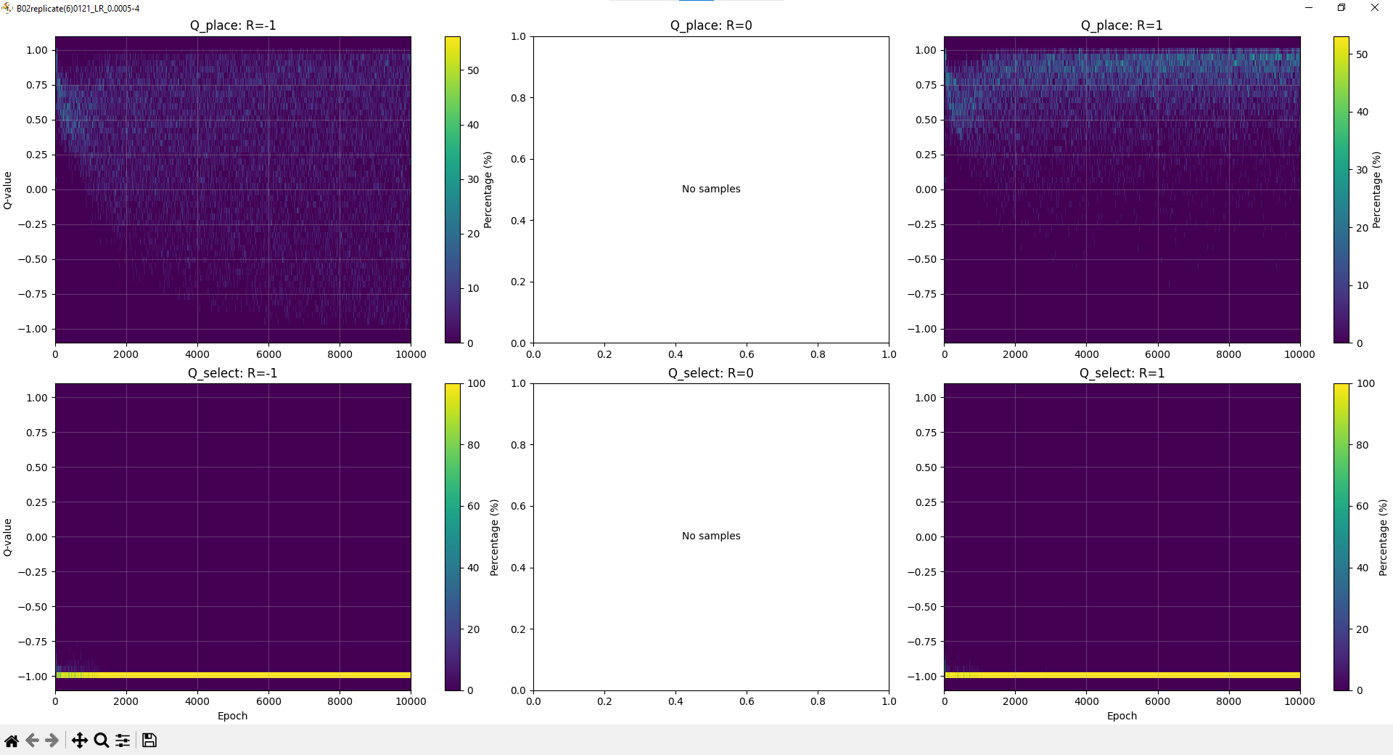

Slide 48
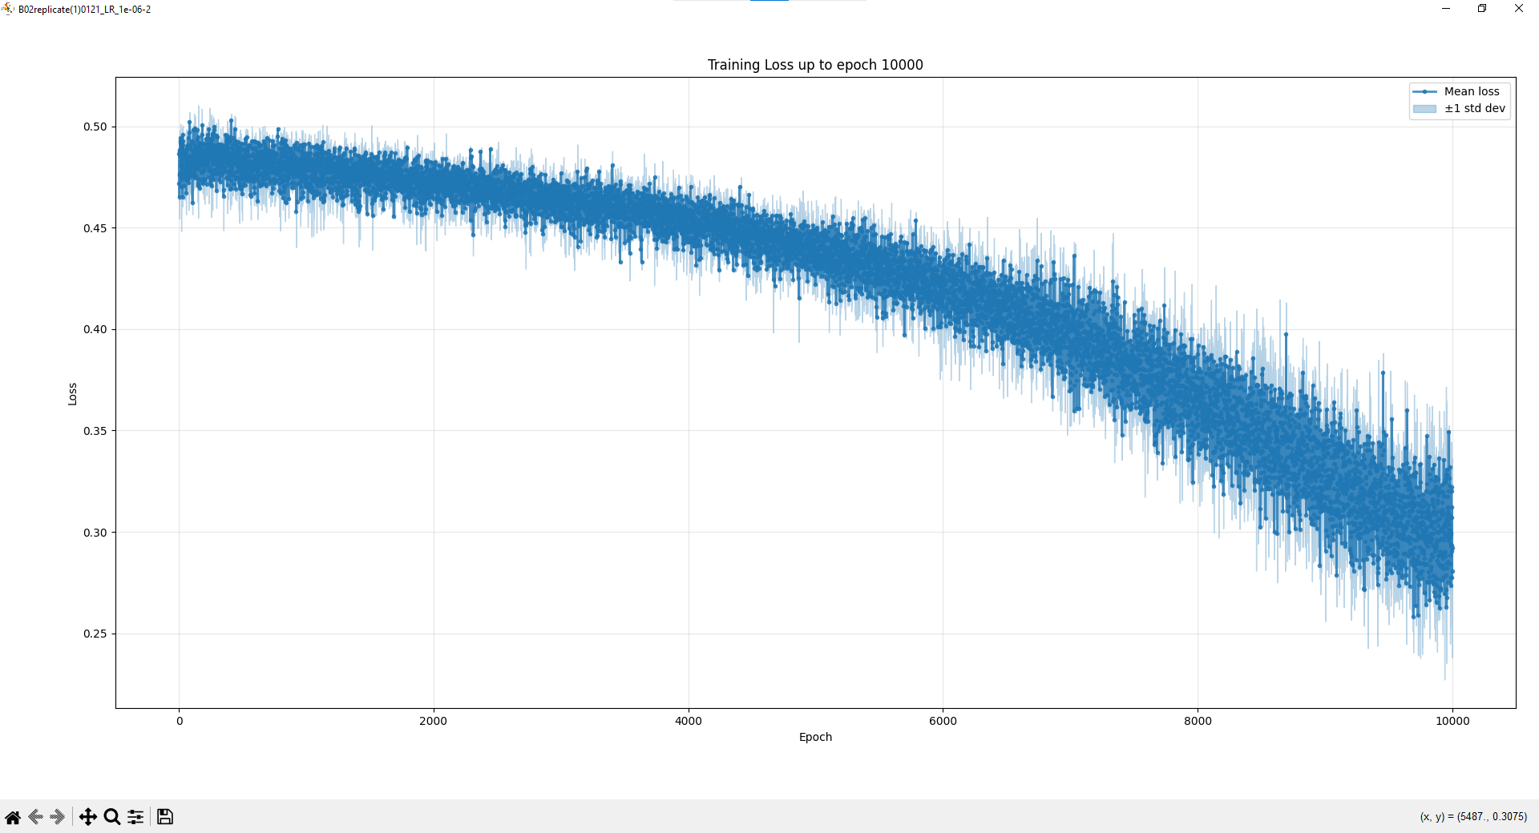

Slide 49
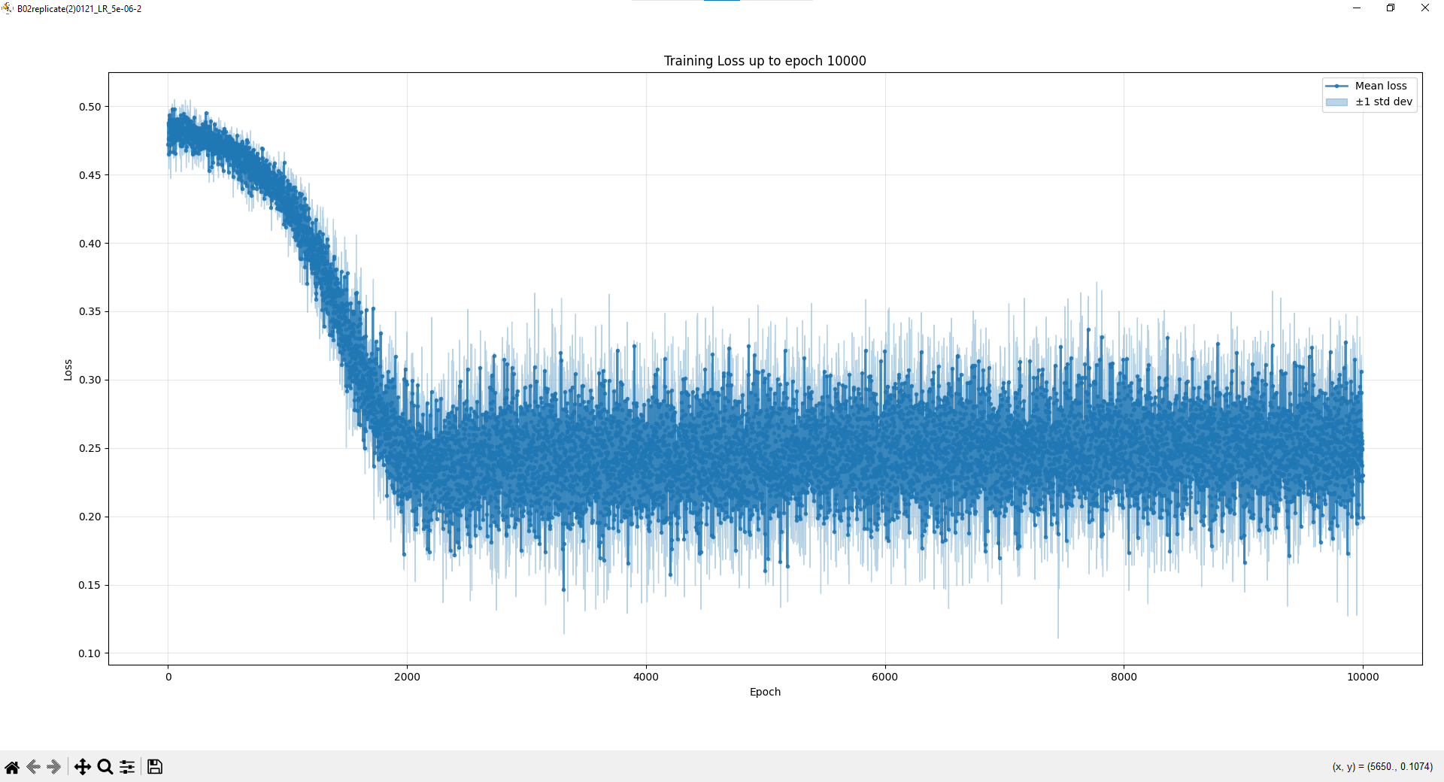

Slide 50
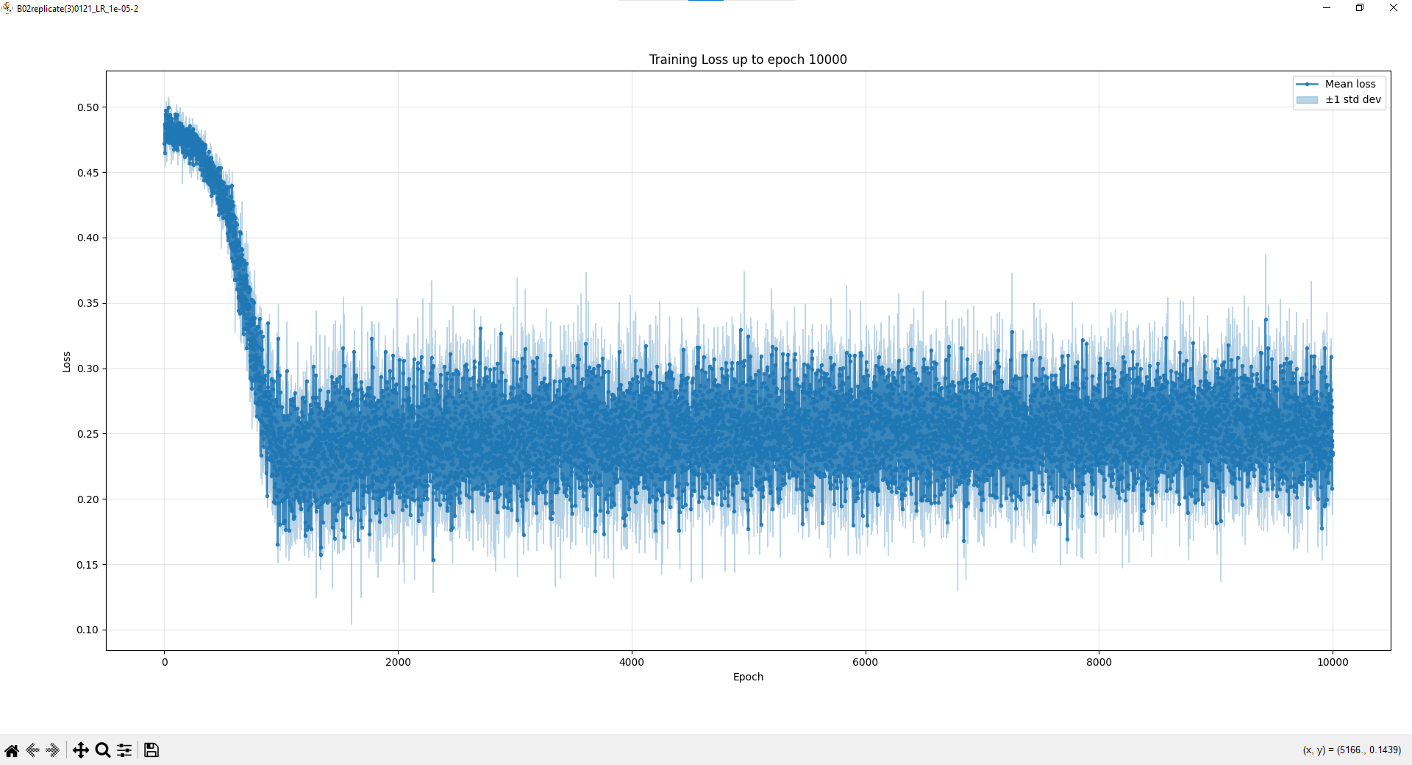

Slide 51
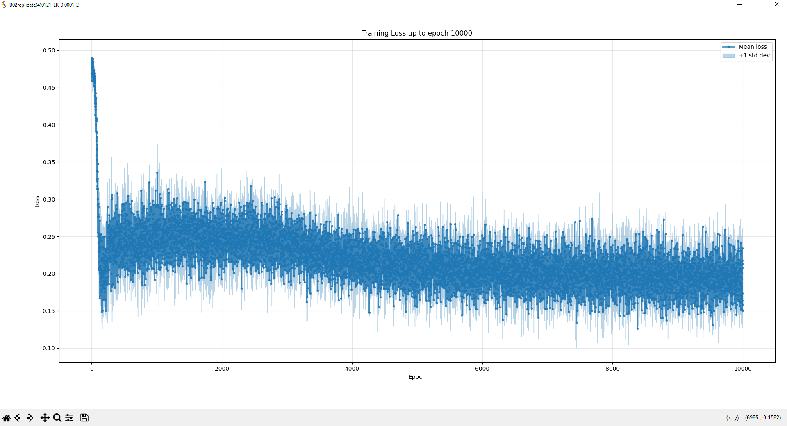

Slide 52
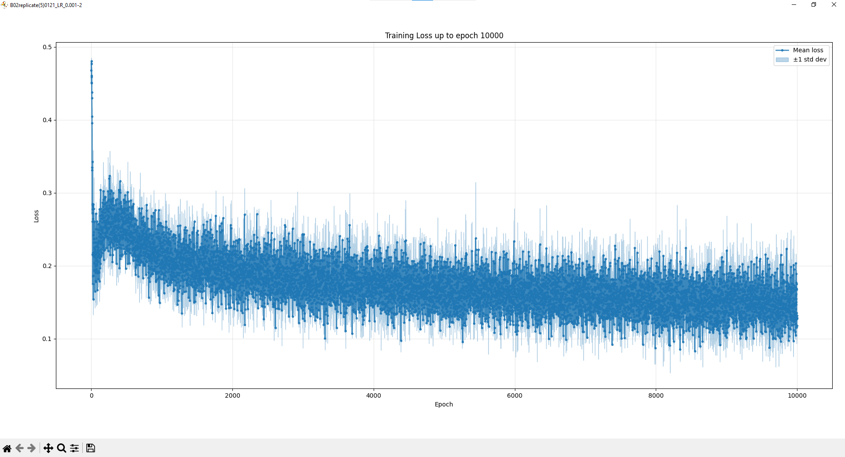

Slide 53


Slide 54
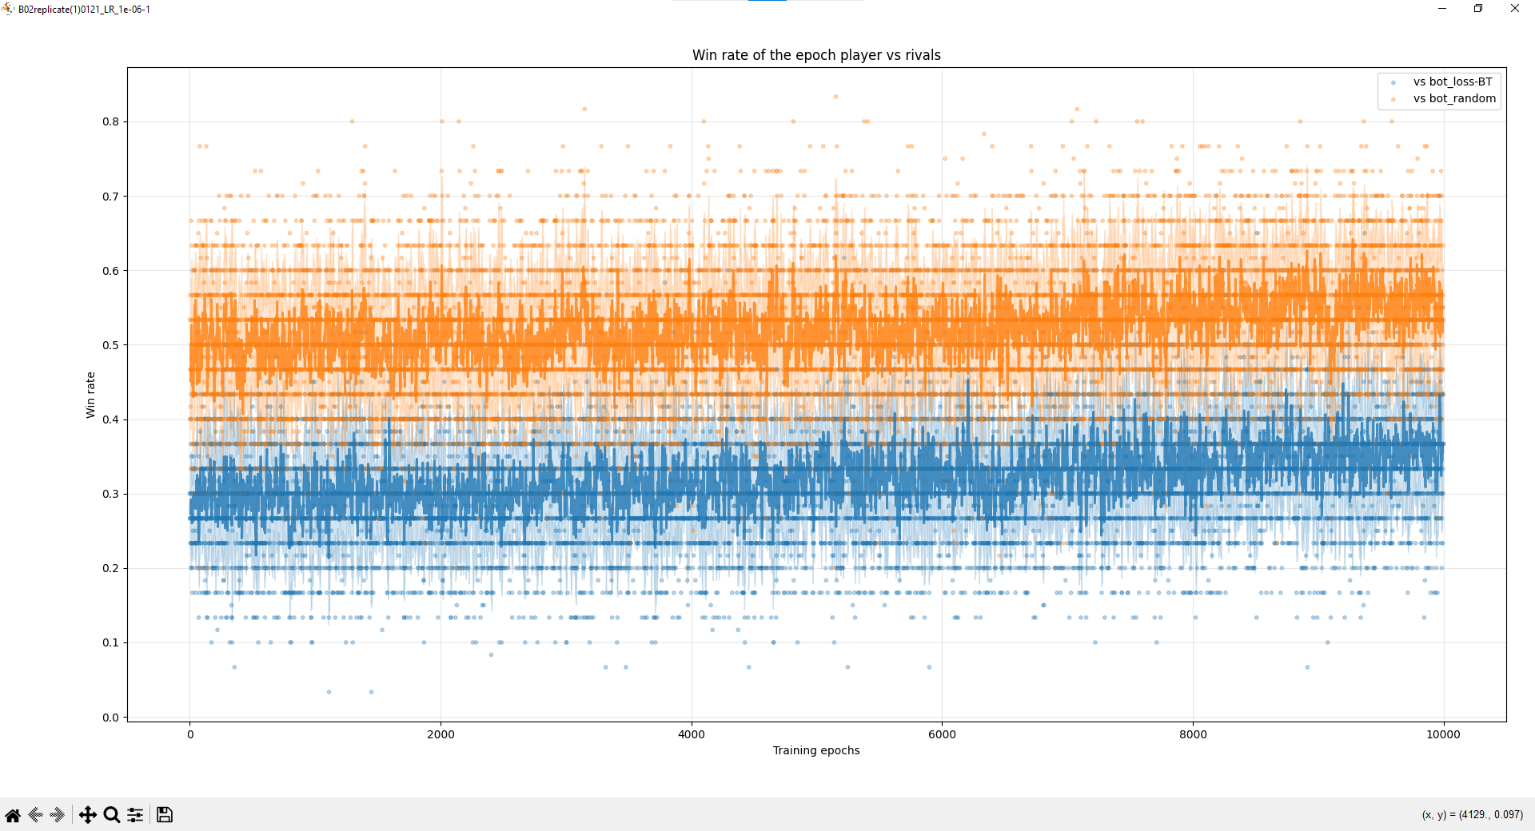

Slide 55
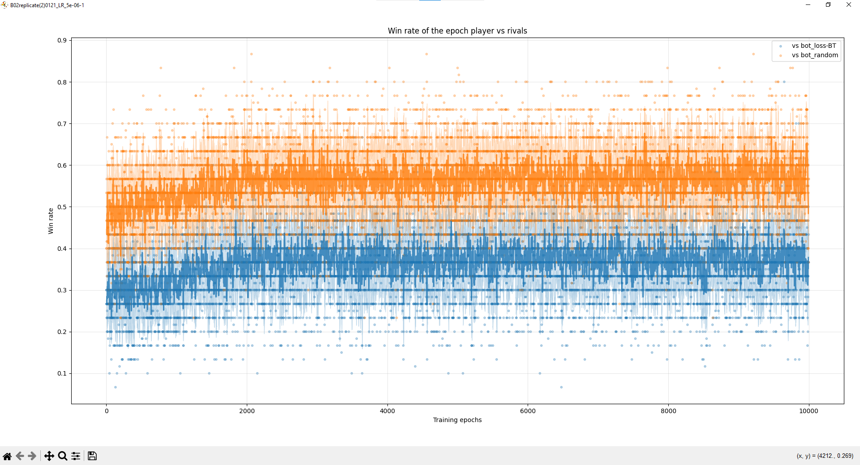

Slide 56
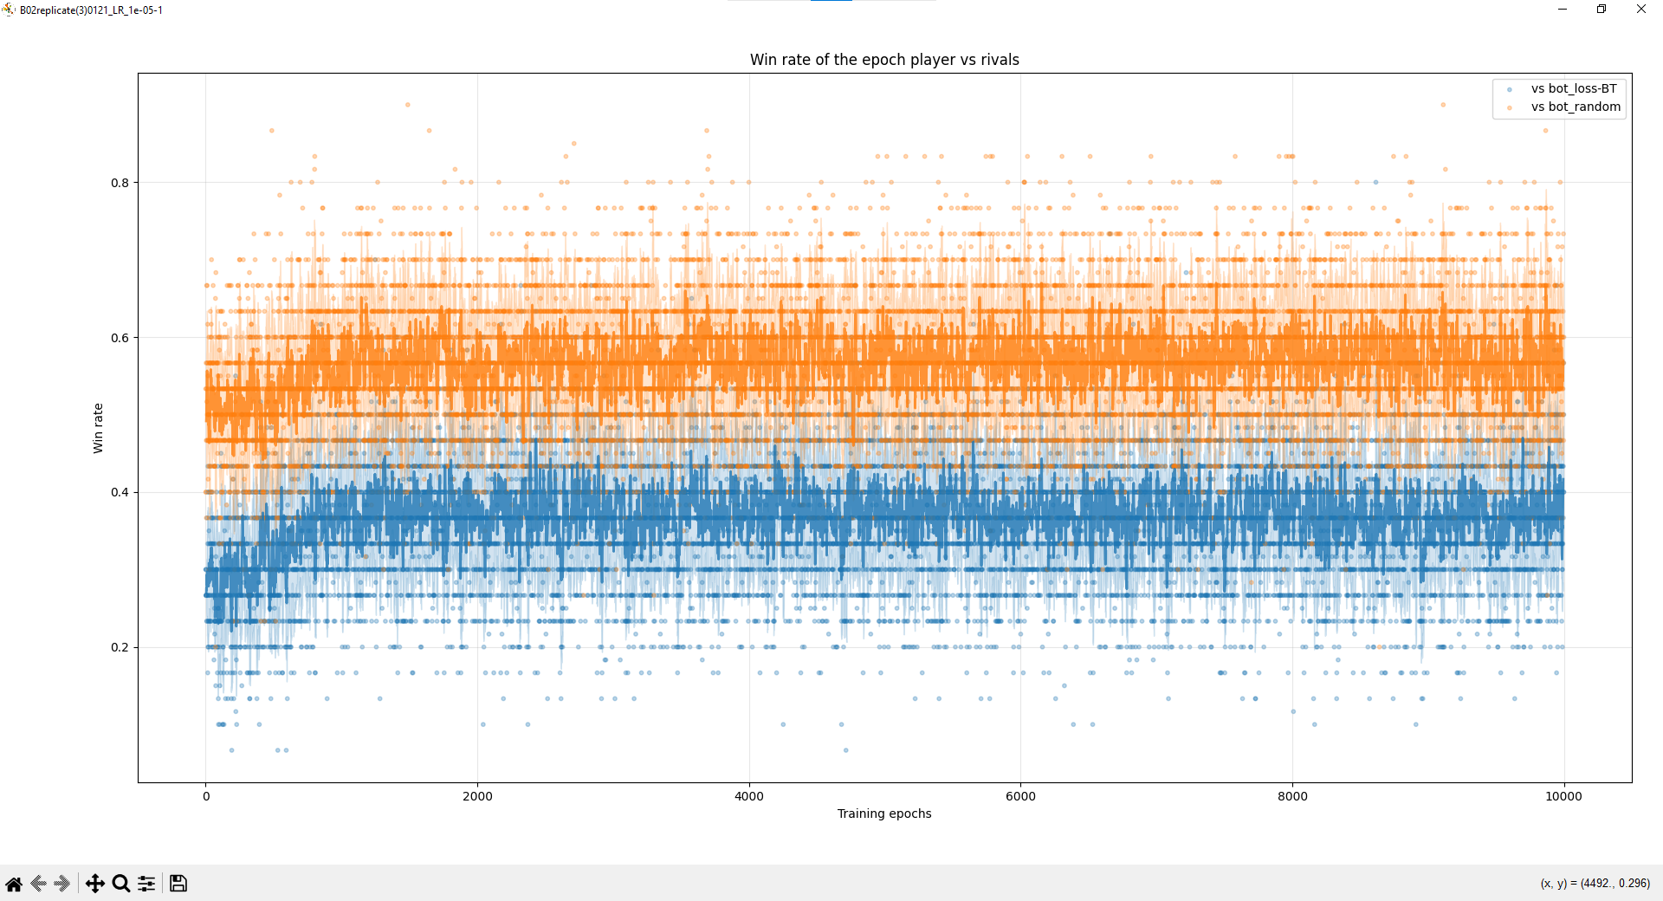

Slide 57
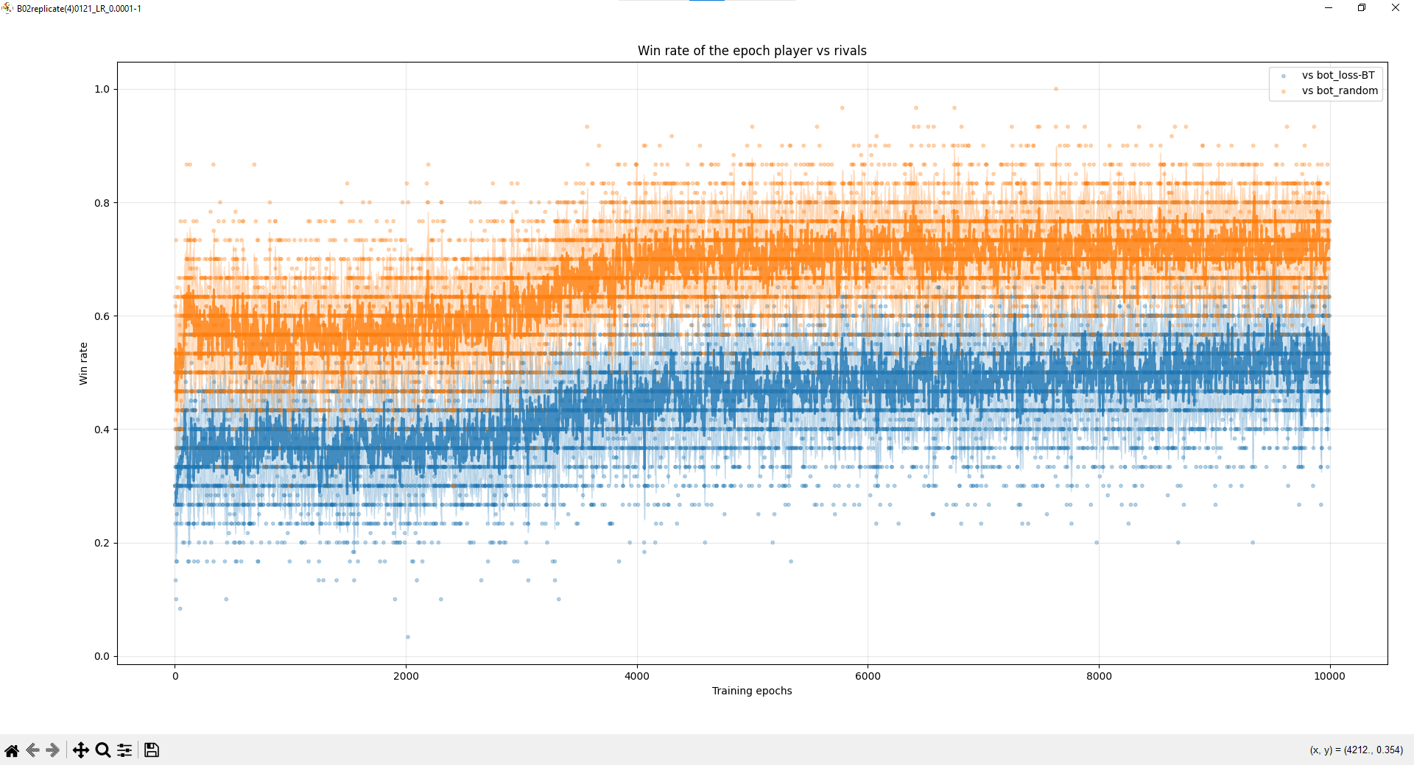

Slide 58
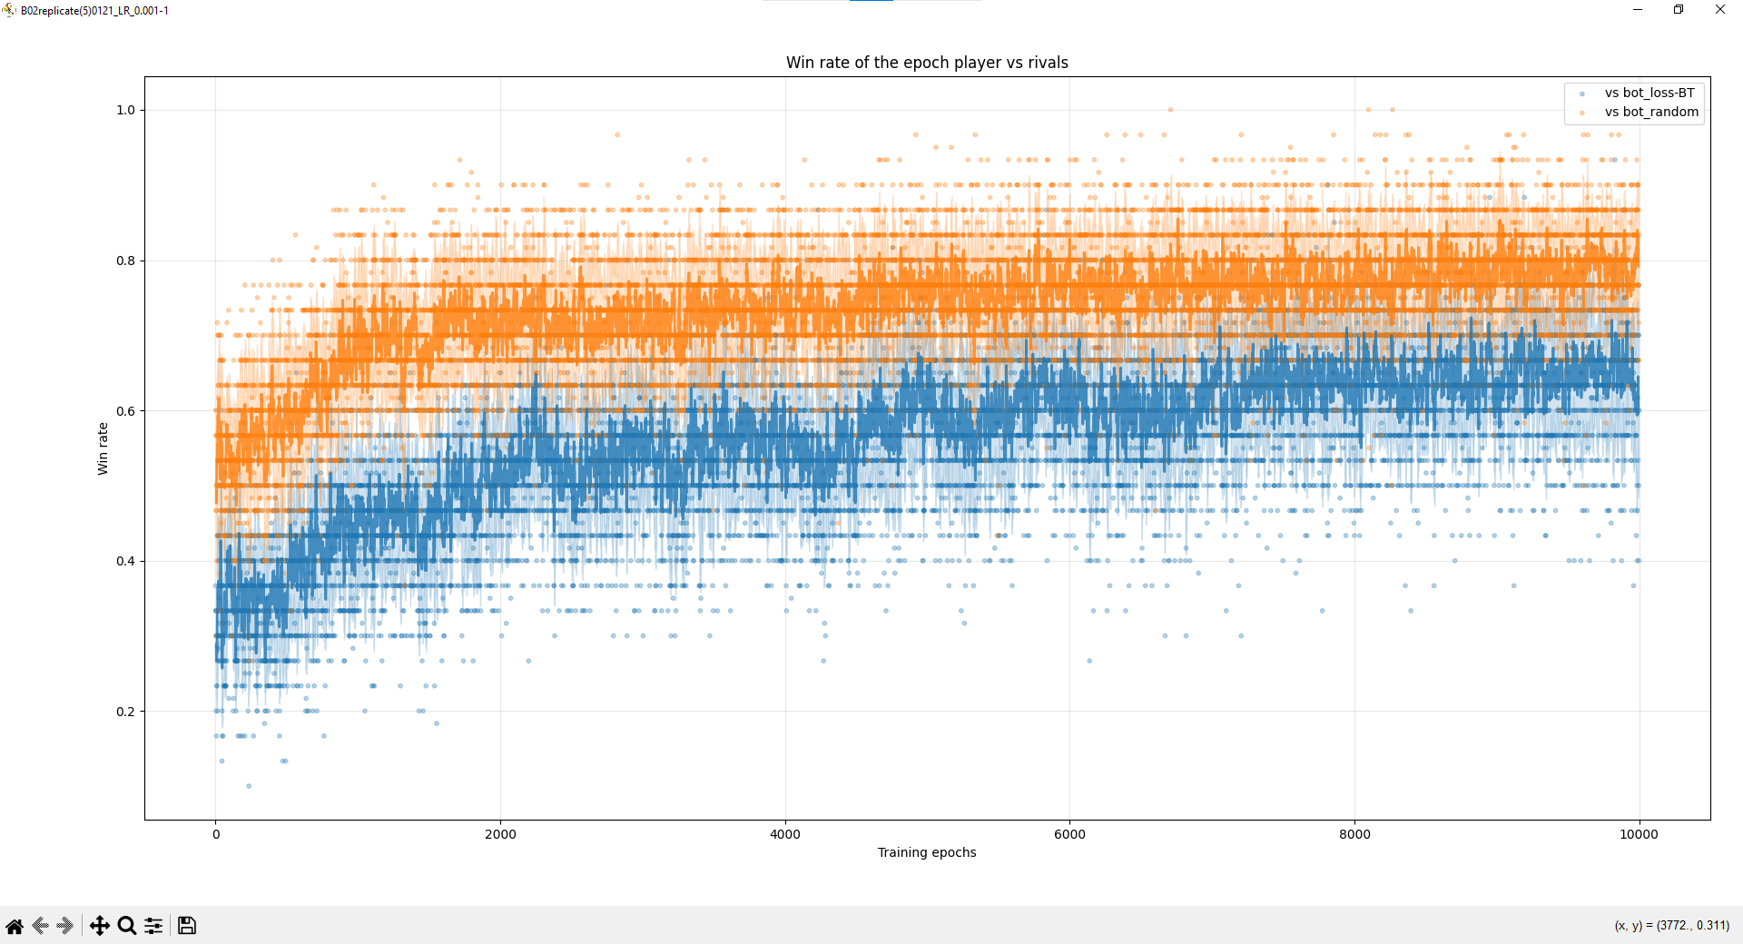

Slide 59


